Slide 1
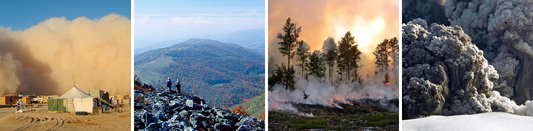




MODIS Atmospheres webinar series #4: Collection 6 e-Deep Blue/Dark Target comparison and ‘merged’ aerosol products
Deep Blue group: N. Christina Hsu (PI), Andrew M. Sayer, Corey Bettenhausen, Nick Carletta , M. J. Jeong, Jaehwa Lee
Dark Target group: Rob Levy (PI), Shana Mattoo, Leigh Munchak, Falguni Patadia, Pawan Gupta, Rich Kleidman
(With thanks to previous team members, the MODIS Characterization Support Team, the AERONET group and site PIs/managers, and many others)
Climate & Radiation Laboratory, NASA Goddard Space Flight Center
andrew.sayer@nasa.gov
Images from NASA Earth Observatory, http://earthobservatory.nasa.gov/Features/Aerosols/

Slide 2
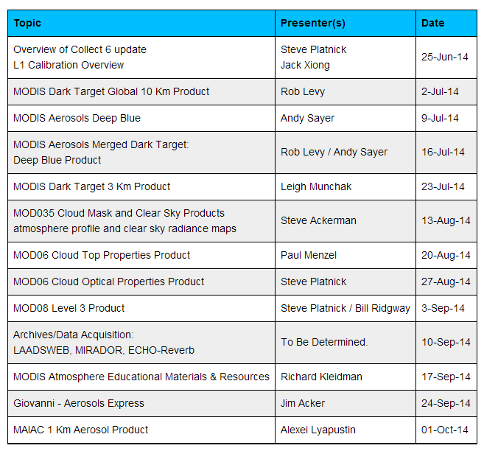
Webinar schedule

Slide 3
Motivation
Q: The Collection 6 MODIS atmosphere aerosol products over land have e-Deep Blue (DB), Dark Target (DT), and ‘merged’ data all available a lot of the time. Which should I use, and when?
A (short): It depends.
A (longer): The next ~45 minutes…

Slide 4
Overview
Aerosols and MODIS overview
MODIS Deep Blue/Dark Target summary
  Global/regional comparison of retrievals
‘Merging’ algorithm
  Description
  Examples
Evaluation against AERONET

Slide 5
Overview
Aerosols and MODIS overview
MODIS Deep Blue/Dark Target summary
  Global/regional comparison of retrievals
‘Merging’ algorithm
  Description
  Examples
Evaluation against AERONET

Slide 6
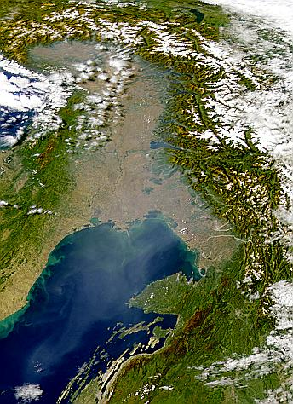
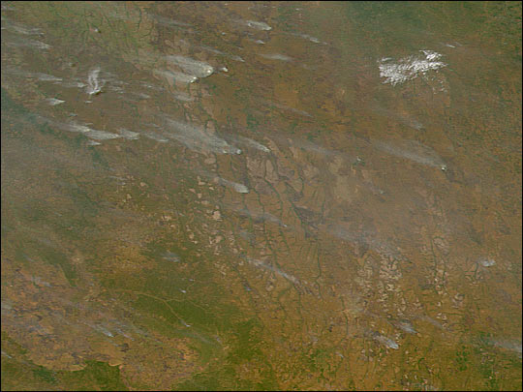
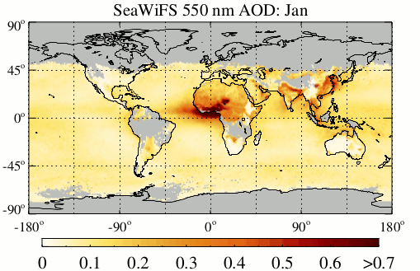
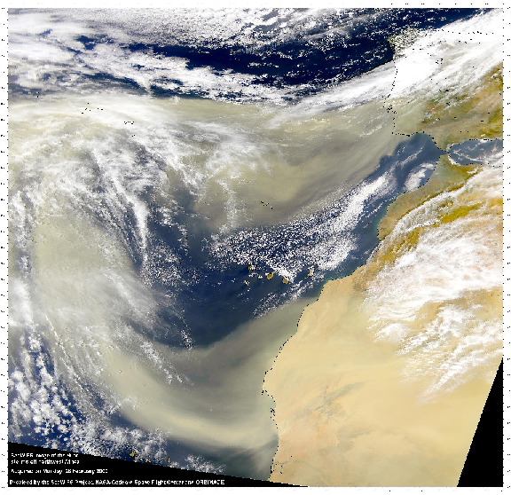
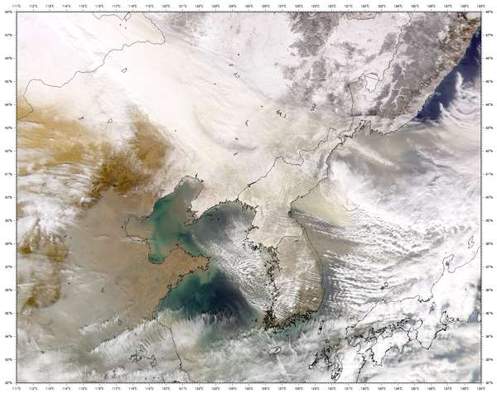
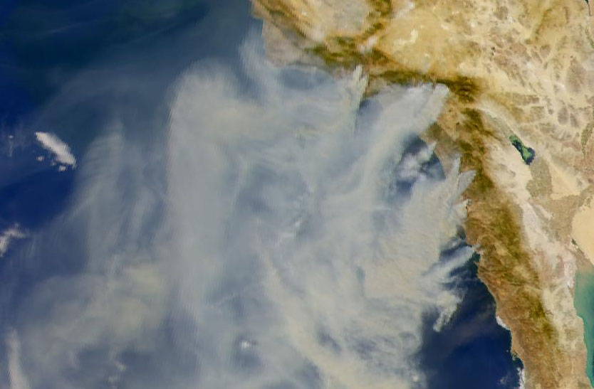
Aerosols and properties of interest: AOD
Aerosol Optical Depth (AOD): total column optical extinction of aerosol at a given wavelength
  Most commonly, 550 nm (τ₅₅₀)
  Related to how much aerosol is in the atmosphere
  Also termed aerosol optical thickness (AOT)

Slide 7
Moderate Resolution Imaging Spectroradiometer (MODIS) terminology
MxD04_L2.AYYYYDDD.HHMM.CCC.YYYYDDDHHMMSS.hdf
MxD04 = Earth Science Data Type name
x = “O” for Terra or “Y” for Aqua
L2 = Denotes a Level-2 product (or L3 for Level-3, etc.)
A = indicates date/time information follows
YYYYDDD = acquisition year and day-of-year
HHMM = acquisition hour and minute start time
CCC = collection (e.g., ‘006’ for Collection 6)
YYYYDDDHHMMSS = production data and time
hdf = denotes HDF file format
A ‘Collection’ is a MODIS mission (re)processing; Collection 6 is the new version
Data products relevant to this presentation:
  MOD04, MYD04 Level 2 (orbit-level) aerosols
  MODATML2, MYDATML2 Level 2 joint atmospheres
  MOD08, MYD08 Level 3 (aggregated) joint atmospheres

Slide 8
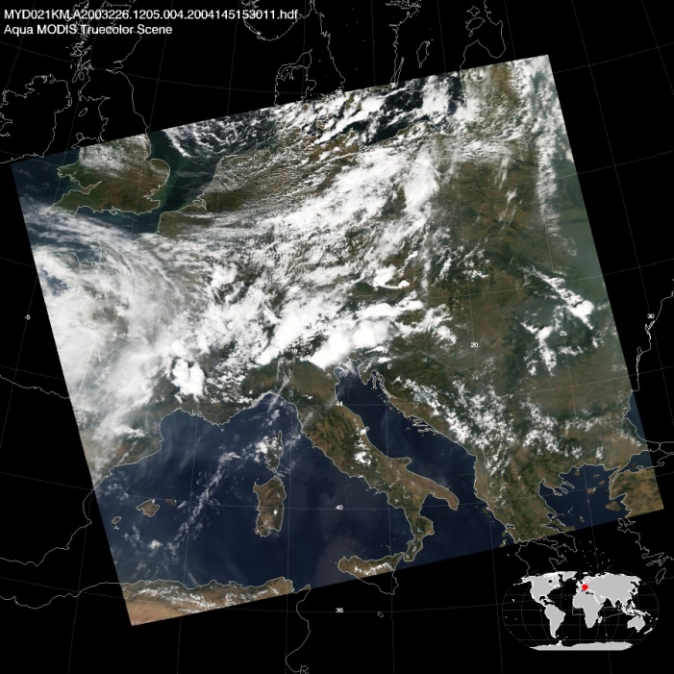
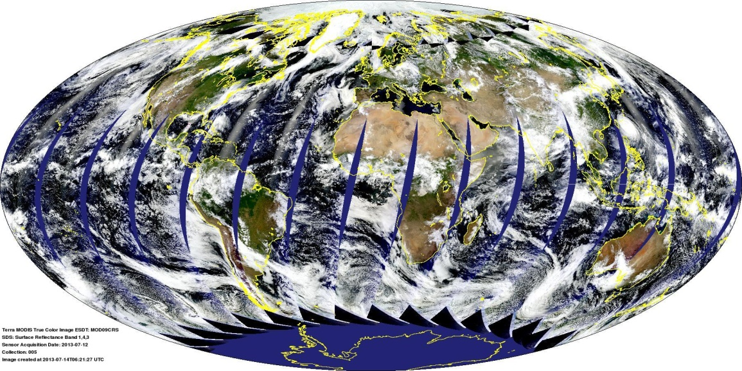
The MODIS sensor
MODIS Terra daytime RGB composite for July 12th, 2013
MODIS Aqua granule RGB composite for August 14th, 2003, 12:05 UTC
Images available online at http://modis-atmos.gsfc.nasa.gov
36 spectral bands from visible to thermal IR
Spatial resolutions (level 1b) 250 m to 1 km at nadir
  ‘Bowtie effect’ leads to pixel enlargement and distortion near swath edges
Swath width 2,300 km, giving near-global daily coverage
Flying on polar-orbiting platforms
  Near-constant local solar time of observation ~10:30 am (Terra, descending), ~1:30 pm (Aqua, ascending)
  14-15 orbits per day, 16-day orbital repeat cycle
  Data organised into 5-minute ‘granules’

Slide 9
Overview
Aerosols and MODIS overview
MODIS Deep Blue/Dark Target summary
  Global/regional comparison of retrievals
‘Merging’ algorithm
  Description
  Examples
Evaluation against AERONET

Slide 10
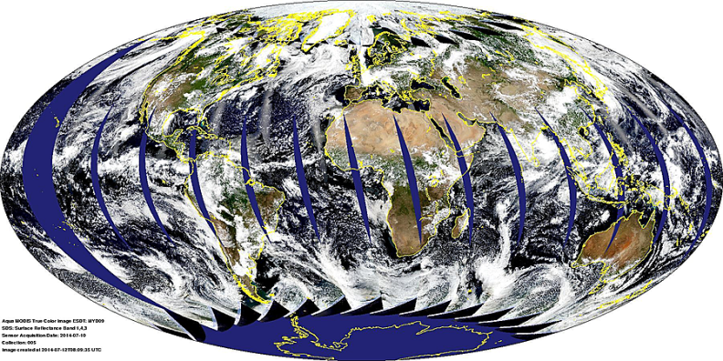
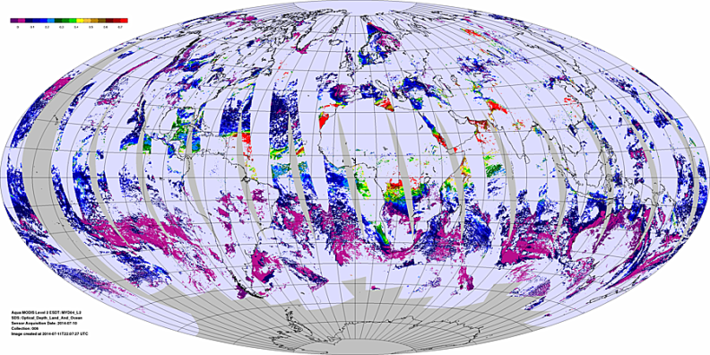
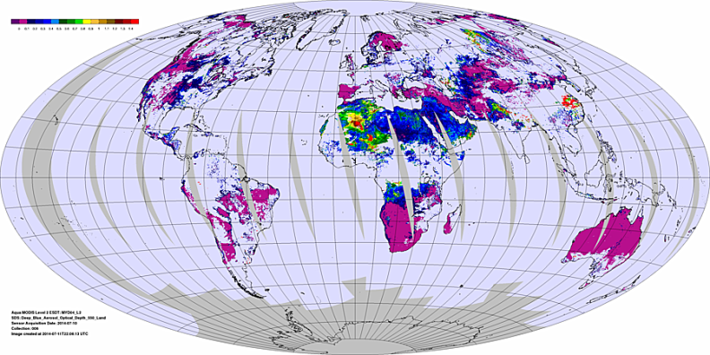
MODIS Atmospheres aerosol products basics
Browse images from http://modis-atmos.gsfc.nasa.gov/IMAGES/index.html
RGB
Three aerosol algorithms in MxD04:
Enhanced Deep Blue (DB/eDB, land only)
Dark Target (DT, dark land only)
Ocean (water only)
DT/ocean
DB
Level 2 (MxD04) nominal pixel resolution10x10 km at nadir
Other aerosol algorithms (not discussed here) exist, e.g. :
  MODIS: MAIAC, land/ocean surface ‘atmospheric correction, regional algorithms
  Non-MODIS sensors too (e.g. MISR, SeaWiFS, VIIRS, AVHRR, POLDER, ATSR, MERIS, geostationary, etc…)

Slide 11
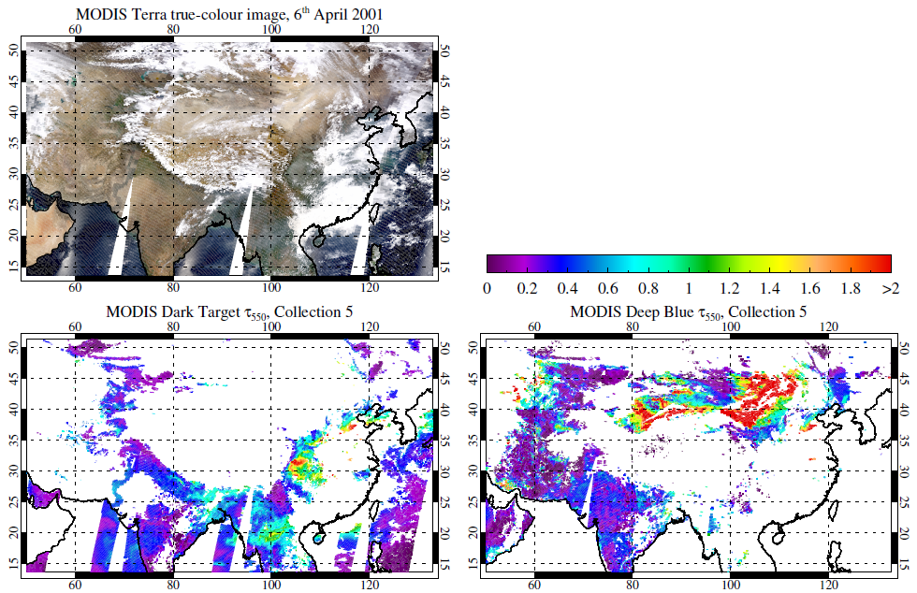
MODIS aerosols as of Collection 5
Ocean: one algorithm
Land: two algorithms, minimal spatial overlap
  Dark Target algorithm over (mainly) vegetated surfaces
  Deep Blue algorithm over bright surfaces (e.g. deserts)
    In C6, it does more than that
  This provided the initial rationale for the merge

Slide 12
Algorithm summaries
Characteristic | e-Deep Blue (DB) | Dark Target (DT) | Ocean
Domain | Land | ‘Dark’ (i.e. partly/fully vegetated) land | Dark (i.e. non-turbid/shallow) water
Averaging method | Retrieve then average | Average then retrieve | Average then retrieve
Aerosol optical model | Prescribed regionally/seasonally Sometimes retrieved | Fine model prescribed regionally/seasonally Coarse (dust analogue) model mixed in | Combination of 4 fine and 5 coarse modes ‘Best’ and ‘average’ solutions reported
Surface properties prescribed | Database or type-dependent dynamic, pseudo-Lambertian | Global dynamic relationship, pseudo-Lambertian | BRDF model incorporating glint, whitecaps, and fixed underlight
550 nm AOD uncertainty confidence envelope | ~+/-(0.03+0.2*AOD_{MODIS}) (depends on geometric air mass) | +/-(0.05+0.15*AOD_{AERONET}) | +(0.04+0.1*AOD_{AERONET}) to -(0.02+0.1*AOD_{AERONET})
All algorithms are only applied over daytime, cloud-free, snow/ice-free pixels
All results shown hereafter, unless noted otherwise, are:
  Only for retrievals passing each algorithm’s quality assurance (QA) checks
  For Aqua data
  For AOD at 550 nm

Slide 13
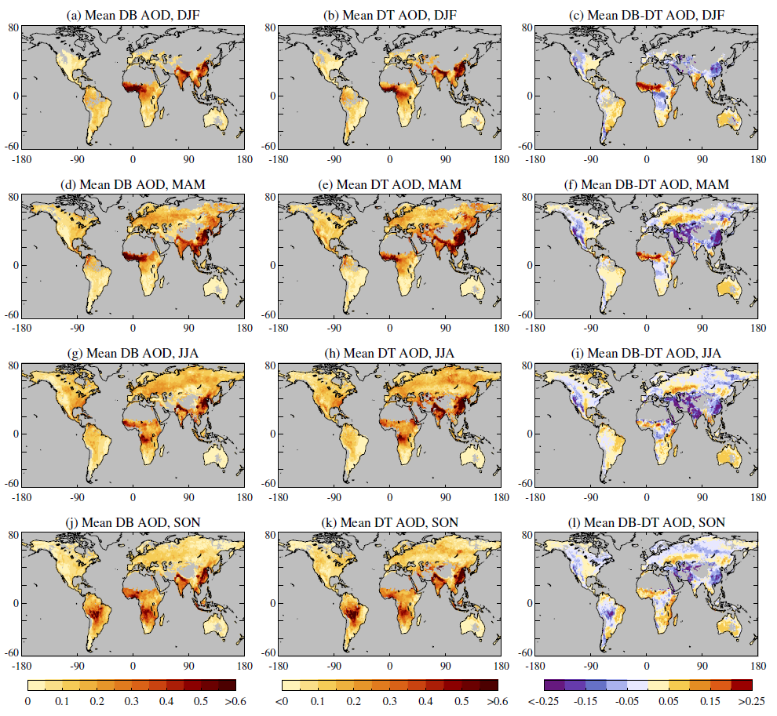
Seasonality of AOD
Seasonal mean AOD:
  Left column: DB
  Middle column: DT
  Right column: DB-DT difference
  Maps use only colocated retrievals
Similar global AOD patterns and seasonal cycles
Regional/seasonal offsets, often within retrieval uncertainty

Slide 14
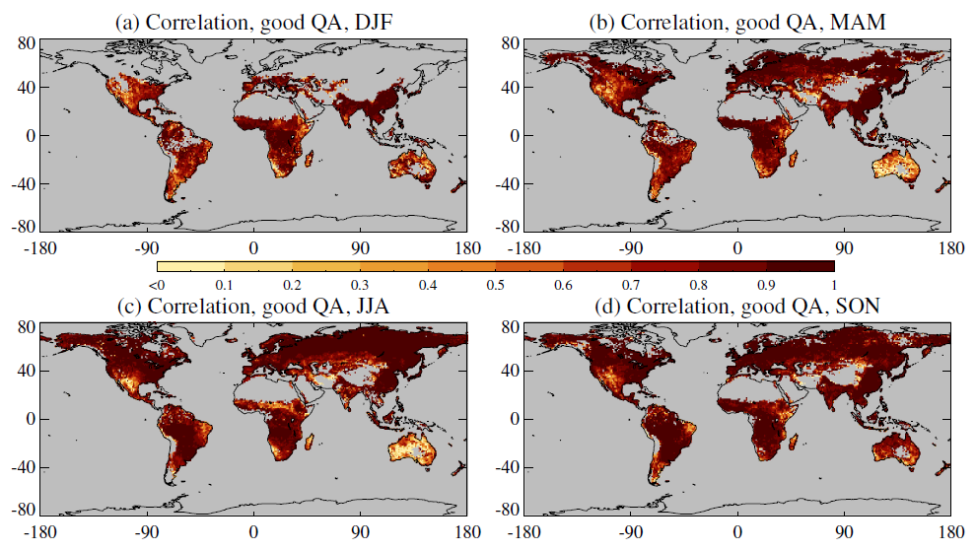
Correlation between DB and DT
Over much of the world, DB and DT AOD are highly correlated (r>0.9) within a season
  That does not imply that they are correct
Lower correlations where AOD is persistently low, and/or surface conditions tricky for one/both algorithms
  Australia, Sertão area of Brazil, mountains

Slide 15
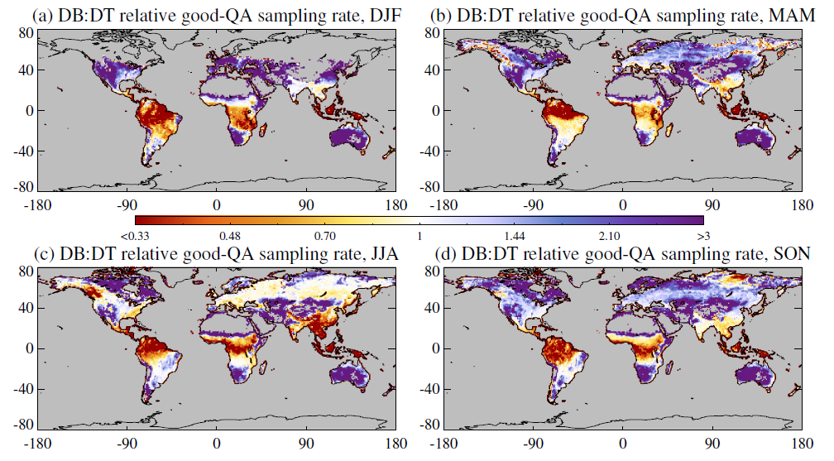
Sampling rate
Ratio of number of retrievals passing QA checks, for regions where both algorithms provide retrievals
  DB tends to provide retrievals more frequently at mid/high-latitudes (purple)
  DT tends to provide retrievals more frequently in the tropics (red)
  In North America, Europe and India, often similar data volume

Slide 16
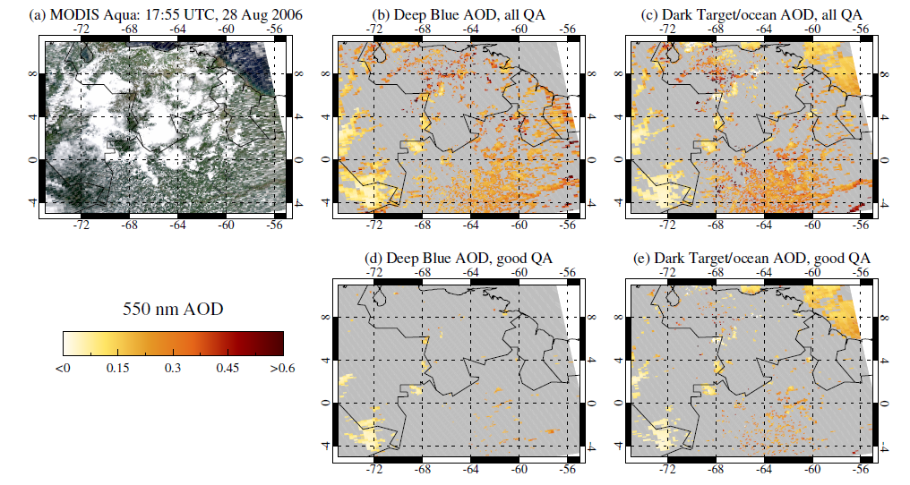
Granule-level comparisons
Sampling frequency in tropical reasons determined in part by occurrence of small cumulus clouds
  DB discards more data than DT near cloud edges

Slide 17
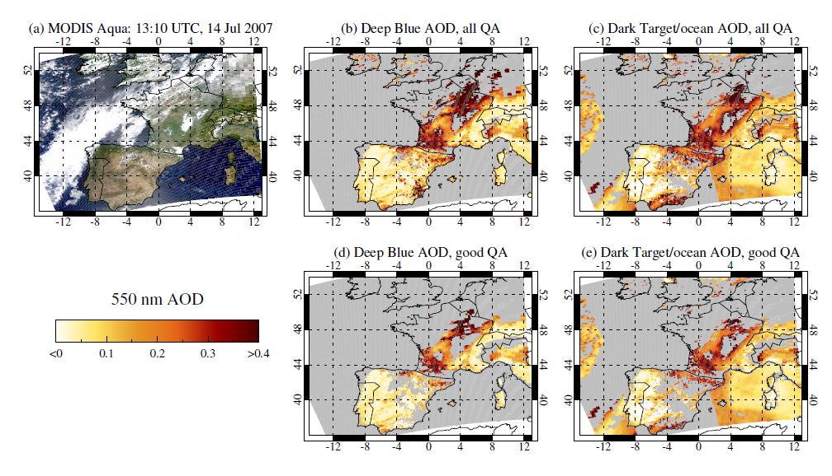
Granule-level comparisons
Where other cloud types dominate, extent of near-cloud spatial coverage tends to be more similar

Slide 18
Overview
Aerosols and MODIS overview
MODIS Deep Blue/Dark Target summary
  Global/regional comparison of retrievals
‘Merging’ algorithm
  Description
  Examples
Evaluation against AERONET

Slide 19
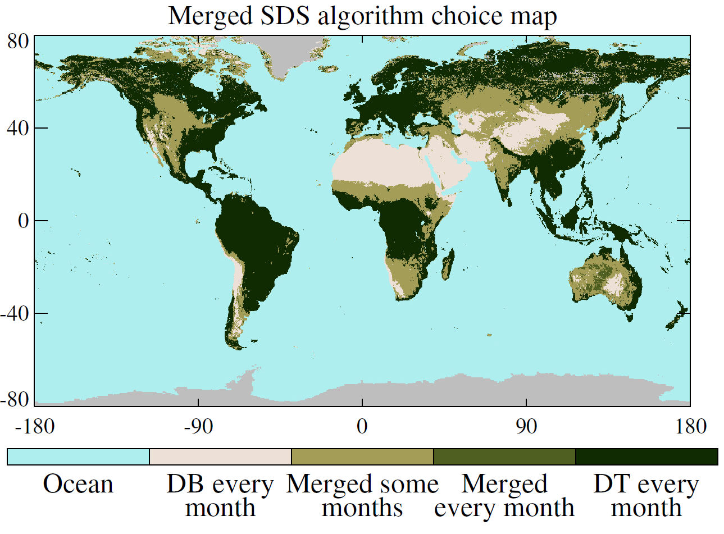
What is the ‘merged’ MODIS dataset?
This first attempt largely mimics Collection 5 user habits: use Deep Blue to fill in gaps in the Dark Target/ocean dataset
  Only contains retrievals passing QA checks
12 monthly climatologies of NDVI used to assign retrievals over land:
  NDVI < 0.2: Deep Blue
  NDVI > 0.3: Dark Target
  Otherwise: pick the algorithm with higher QA value, else average if both QA=3
Ocean algorithm used over water

Slide 20
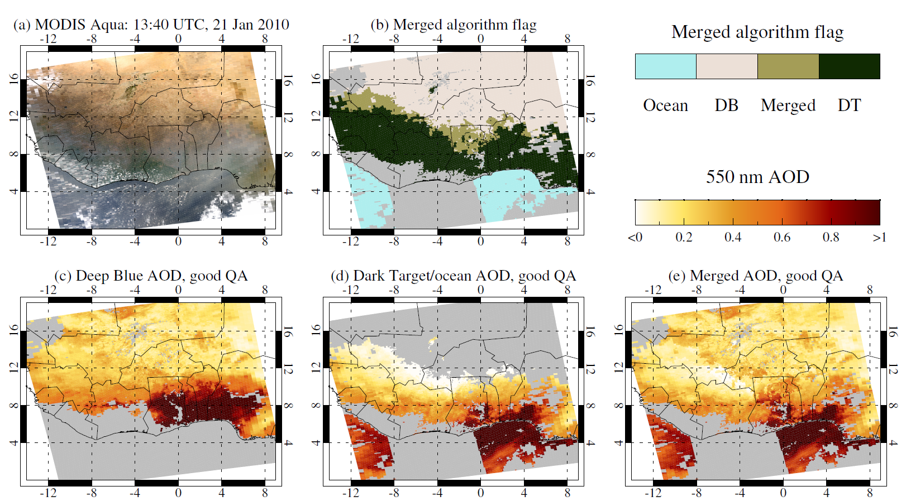
Example granule showing the merging procedure

Slide 21
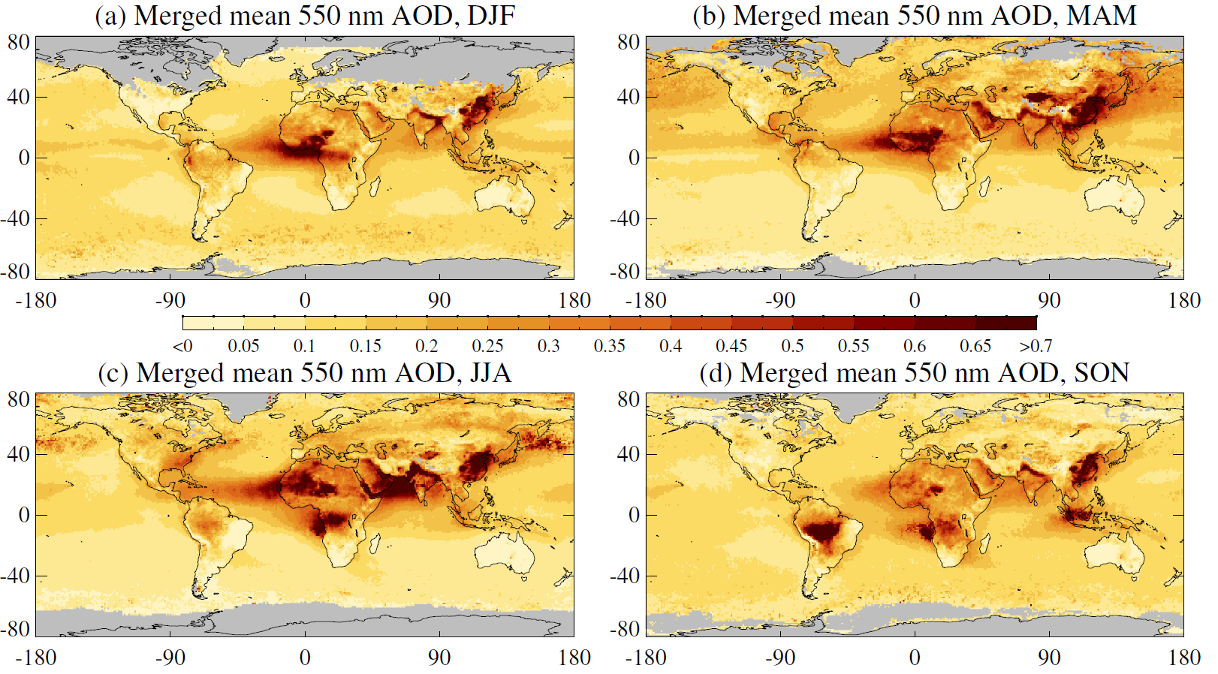
Seasonal average ‘merged’ AOD
Seasonal mean of daily mean AOD from the ‘merged’ SDS, 2006-2008

Slide 22
Overview
Aerosols and MODIS overview
MODIS Deep Blue/Dark Target summary
  Global/regional comparison of retrievals
‘Merging’ algorithm
  Description
  Examples
Evaluation against AERONET

Slide 23
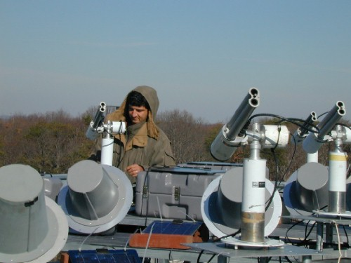
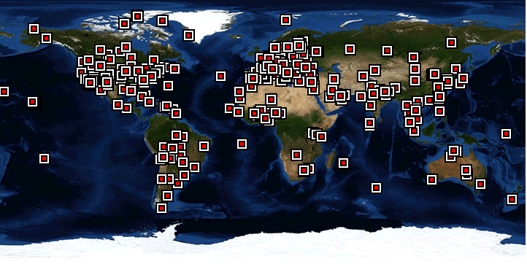
Evaluation against AERONET
Images from NASA AERONET page, http://aeronet.gsfc.nasa.gov/
Comparison methodology:
Average AERONET AOD within 30 minutes of satellite overpass
Average MODIS AOD within 25 km of AERONET site
Compare AOD at 550 nm
Aerosol Robotic Network (AERONET): A standard resource for satellite AOD validation
  Global network with consistent protocols, reference calibration
  Several hundred sites with at least 1 year of observations
  Also have a ship-borne Maritime Aerosol Network for over-ocean coverage (not shown)

Slide 24
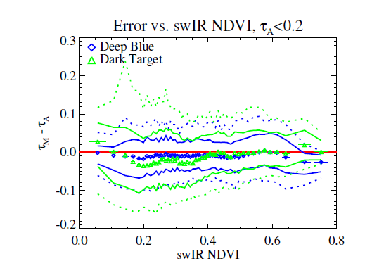
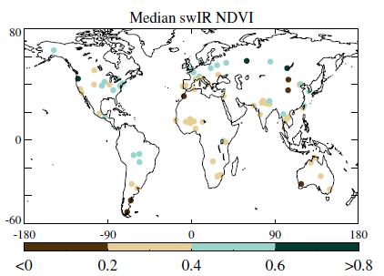
DB vs. DT: surface-related biases
Median (symbols) and confidence envelopes (68%, 90%) of DB and DT AOD bias vs. AERONET with respect to swIR NDVI, for low-AOD cases
Higher swIR NDVI for (generally) a more densely-vegetated surface
Shows similar (small) biases in both datasets, DT has more scatter at less-vegetated surfaces
These low AOD cases are a majority (~80% of points)

Slide 25
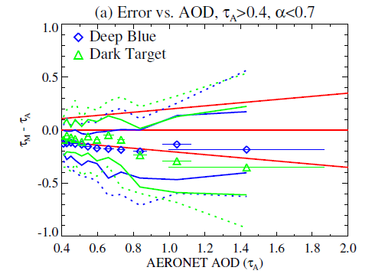
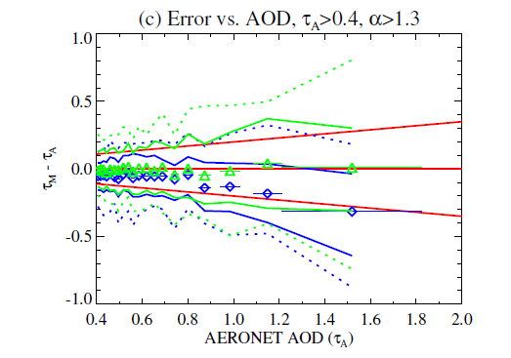
DB vs. DT: aerosol-related biases
Median (symbols) and confidence envelopes (68%, 90%) of DB and DT AOD bias vs. AERONET AOD, split by AERONET Ångström exponent (AE)
Left plot: low AE (e.g. dust)
  DB has slight low bias, DT has bias becoming more negative with increasing AOD
Right plot: high AE (e.g. smoke, urban pollution)
  DT has little bias, DB has bias becoming more negative with increasing AOD
Width of error distributions similar
These high AOD cases are a minority (<10%) of points

Slide 26
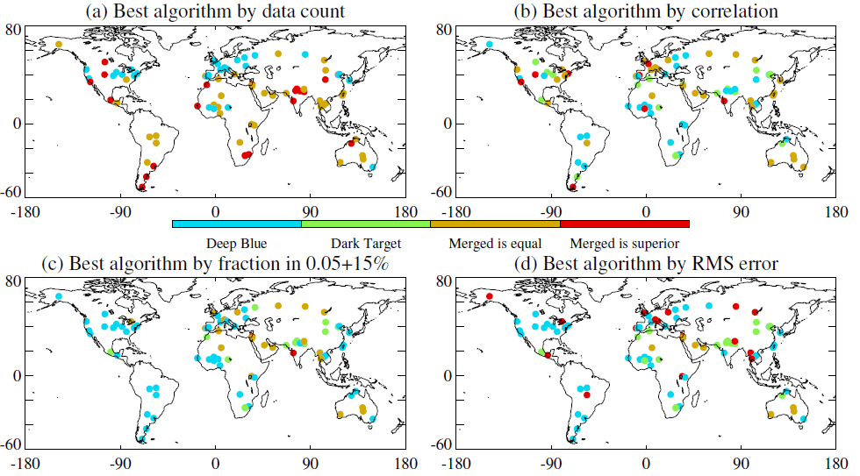
Global comparison
Maps show ‘best’ algorithm, by different metrics, at each AERONET site
  Gold: merged SDS takes only DB or DT retrievals; Red: merged mixes DB and DT, and does better than both
Which is best depends on what statistical metric you’re interested in
  The merged dataset tends to have a higher data volume
  However, DB or DT outperform by other metrics at some sites
  Thus, usage choices may depend on whether analyses are regional or global

Slide 27
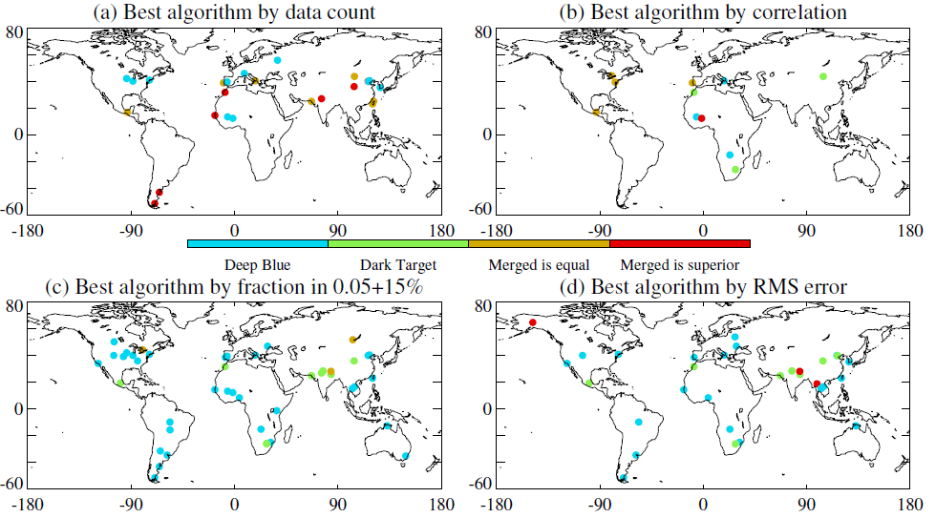
Where does performance quality differ?
As before, but only where different in algorithm quality is large
Fewer sites plotted, i.e. level of performance is similar at many sites

Slide 28
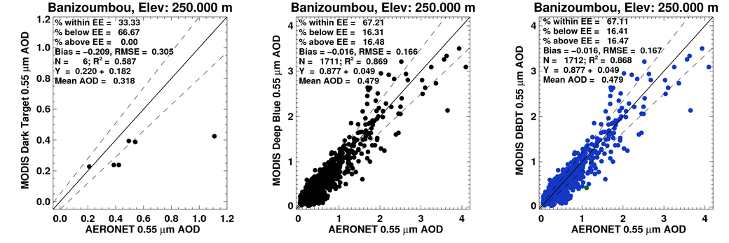
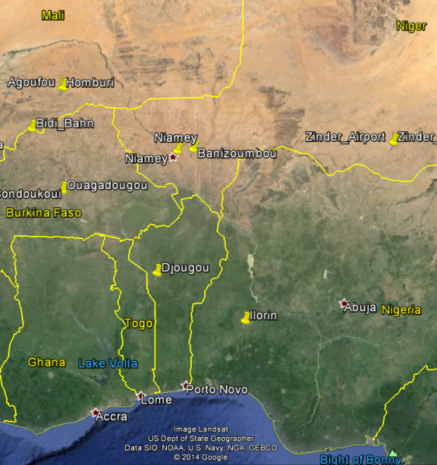
Example: Banizoumbou (Niger)
Dark Target
Deep Blue
Merge
DB performs well
DT has few retrievals
Merge mostly draws from DB (blue)
Map from Google Earth

Slide 29
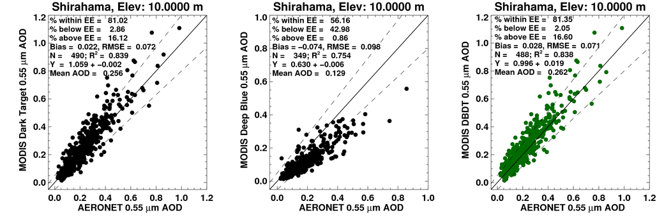
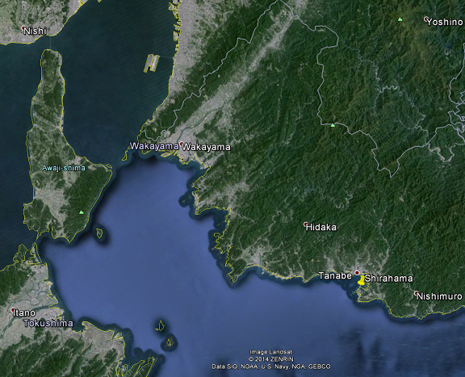
Example: Shirahama (Japan)
Dark Target
Deep Blue
Merge
DT performs well, slight high bias
DB has fewer retrievals, and low bias
Merge mostly draws from DT (green)
Map from Google Earth

Slide 30
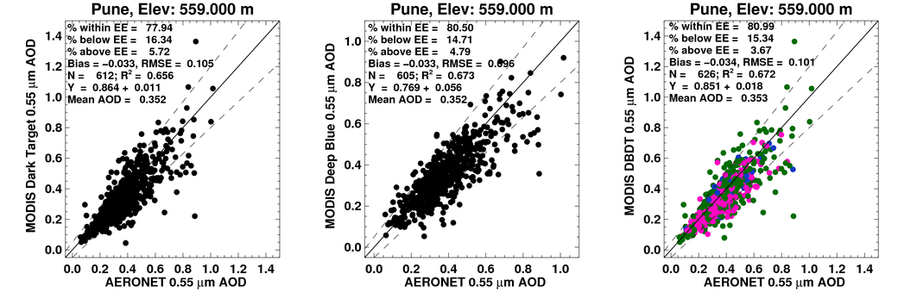
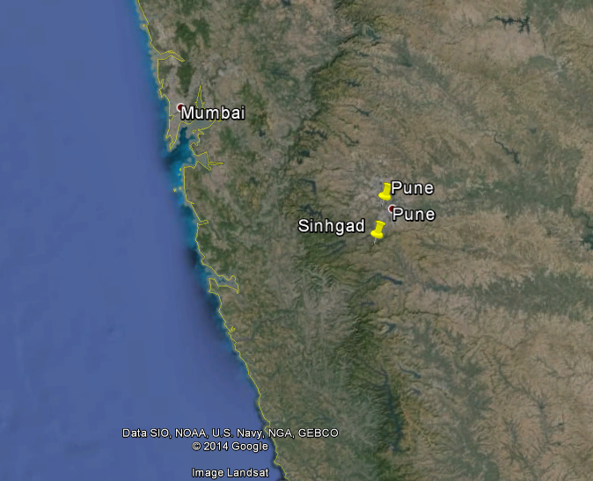
Example: Pune (India)
Dark Target
Deep Blue
Merge
Both DB and DT perform well
Merge sometimes draws from DT (green), sometimes DB (blue), sometimes merges (red)
Slightly better performance overall from the merge than either DB or DT
Map from Google Earth

Slide 31
Summary
Deep Blue (DB) and Dark Target (DT) provide similar views of the global aerosol system from MODIS
  Often agree closely, but this doesn’t imply both are correct, and should not be considered as independent datasets
Neither algorithm, or their merge, is consistently better than the others
Quality of performance is often very similar between algorithms
  In many areas, it will likely not matter much which algorithm is used
  Usage recommendations are more complicated than can be presented concisely
  DB is still the only option over deserts, and there is only one ocean algorithm, so for global analyses use of the merge may be simplest
  Encourage users to do analyses with both DB and DT data, where practical
  We expect results for Terra will be quantitatively similar
Please contact us with questions, comments, interesting results
Links:
MODIS Atmospheres website: modis-atmos.gsfc.nasa.gov
NASA LAADS (data distribution) website: ladsweb.nascom.nasa.gov
MODIS Collection 6 on the NASA LAADS ftp server: ladsweb.nascom.nasa.gov/allData/6/<product name>

