Slide 1
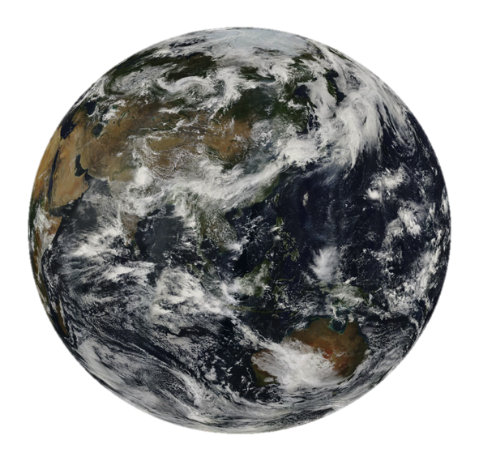
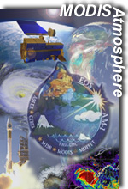
MODIS Atmosphere Team Webinar Series #2:
Overview of Collection 6 Dark-Target aerosol product
Robert Levy (GSFC/613)
NASA Goddard Space Flight Center, Greenbelt, MD
and
Shana Mattoo, Leigh Munchak and Richard Kleidman (SSAI/613) , Falguni Patadia (MSU/613), Pawan Gupta (USRA/614)
2 July 2014
Notes:
Sep: MODIS atmosphere team lead
Jack: Head of the MODIS instrument characterization team

Slide 2
Atmosphere Team Webinar Schedule
http://aerocenter.gsfc.nasa.gov/ext/registration/
Notes:
2nd of 13 presentations from now until the 1st of Oct.
We’ll have consecutive presentations for the next 4 weeks (aerosol products), and then we start up again in mid-August for 3 cloud and clear-sky product talks. That’s followed by a few presentations on practical aspects on acquiring data, etc.

Slide 3
Outline
Overview (where we fit in the MODIS structure)
Basics of Aerosol Retrieval
Basics of DT ocean retrieval
Basics of DT land retrieval
Basics of products and validation
What’s new for Collection 6 Level 2 (MxD04_L2)
New for Level 3 (in regards to aerosol)
Terra vs Aqua (and calibration and trends)
Summary

Slide 4
1. Overview
MODIS Atmosphere Team C6 Webinar #1

Slide 5
MODIS Atmosphere Team Product Organization and People
L1B MOD/MYD02,03
04 Aerosol
(“Dark Target”)
ATML2
(joint sampled product)
Ancillary Data
R. Levy (GSFC)
04 Aerosol
(“Deep Blue”)
S. Platnick
C. Hsu (GSFC)
08
Daily, 8-day, & monthly aggregations
MOD35/MYD35
Cloud Mask
06 Cloud-Top Properties
06 Cloud Optical Properties
S. Ackerman
S. Platnick
S. Platnick
S. Ackerman
(U. Wisconsin)
06 Cirrus Reflectance
05 Near-IR PW
Level-3
B.-C. Gao (no longer supported)
07 Clear-Sky Profiles
05 IR PW
S.Ackerman, P. Menzel
Level-2
MODIS Atmosphere Team C6 Webinar #1
Notes:
PIs or other principal only. Omits a lot of key people but later presentations will get into that.
Not shown: MOD35 and MOD07 both feed into land discipline team processing

Slide 6
Nomenclature and Acronyms
Product “Level” designations
  Level-0 (L0): raw instrument data (digital counts)
  Level-1B (L1B): calibrated/geolocated instrument data
  Level-2 (L2): derived geophysical retrieval data (“pixel” level, along orbit)
  Level-3 (L3): gridded data (spatial and/or temporal aggregation of geophysical products)
MODIS “Collection”
  refers to a (re)processing production run with consistent algorithms
  C5 production began began in summer 2006, reprocessing completed about a year later. C51 update in late 2008.
  Collection 6 (C6) Aqua L2 production began in Dec 2013.
  C6 Terra will hopefully begin soon.
MODIS Atmosphere Team C6 Webinar #1
Notes:
To facilitate the discussion of data processing in practice, several processing “levels” were first defined in 1986 by NASA as part of its Earth Observing System[7] and steadily adopted since then, both internally at NASA (e. g.,[8]) and elsewhere (e. g.,[9]); these definitions are:
Level Description
0 Reconstructed, unprocessed instrument and payload data at full resolution, with any and all communications artifacts (e. g., synchronization frames, communications headers, duplicate data) removed.
1a Reconstructed, unprocessed instrument data at full resolution, time-referenced, and annotated with ancillary information, including radiometric and geometric calibration coefficients and georeferencing parameters (e.g., platform ephemeris) computed and appended but not applied to the Level 0 data (or if applied, in a manner that level 0 is fully recoverable from level 1a data).
1b Level 1a data that have been processed to sensor units (e. g., radar backscatter cross section, brightness temperature, etc.); not all instruments have Level 1b data; level 0 data is not recoverable from level 1b data.
2 Derived geophysical variables (e. g., ocean wave height, soil moisture, ice concentration) at the same resolution and location as Level 1 source data.
3 Variables mapped on uniform spacetime grid scales, usually with some completeness and consistency (e. g., missing points interpolated, complete regions mosaicked together from multiple orbits, etc.).
4 Model output or results from analyses of lower level data (i. e., variables that were not measured by the instruments but instead are derived from these measurements).
Processed a C5.1:
C51 Atmosphere L2, L3 products: Aqua C51 reprocessing completed early 2010; Terra C51 reprocessing completed late 2010; Terra Deep Blue algorithm requires L1B polarization corrections (available only through 2007)

Slide 7
MODIS Standardized Filenaming Convention
NASA Earth Science Data filenames for MODIS
MODIS: MxD04_L2.AYYYYDDD.HHMM.CCC.YYYYDDDHHMMSS.hdf
Definition of highlighted text:
MxD04 = Earth Science Data Type name (this is code for the “aerosol” product)
x = “O” for Terra or “Y” for Aqua
L2 = Denotes a Level-2 product (or L3 for Level-3, etc.)
A = indicates following date/time information is for the acquisition (observation)
YYYYDDD = acquisition year and day-of-year
HHMM = acquisition hour and minute start time
CCC = collection (e.g., ‘006’ for Collection 6)
YYYYDDDHHMMSS = production data and time
hdf = denotes HDF file format
Note: There is also a new, higher resolution product: MxD04_3K, that is discussed in future webinar
MODIS Atmosphere Team C6 Webinar #1
Notes:
Homework assignment: to download some L1B files and take a look. When you do, this slide will help you understand the filenaming convention.
HDF4

Slide 8
Formatting of MODIS and many other NASA products
All MODIS products come in HDF-4 format.
In HDF format each file contains both data and metadata
SDS - Each parameter within a MODIS HDF file is referred to as an SDS (Scientific Data Set)

Slide 9
Status of MODIS C6 Production
L1B exists for both Terra and Aqua (MxD02 and MxD03)
Cloud Mask (MxD35) and Atmospheric Profile (MxD07) exist for both Terra and Aqua
Reprocessing of MYD04_L2 products from Aqua MODIS started on 12-06-2013 and has completed.
  Aqua L3 expected to begin in late June
  Terra reprocessing to start after completion of Aqua L3
Both C6 and C5 processing streams will continue in parallel for about a year before being exclusively C6.
Aerosol algorithm has been ported to work on Near Real Time (NRT from LANCE). I don’t know the schedule for production
MODIS Atmosphere Team C6 Webinar #1
Notes:
Land delay

Slide 10
Useful Links
Atmosphere Team Web Site
  Home page, news, etc.: modis-atmos.gsfc.nasa.gov
  L2 Global Browse imagery: http://modis-atmos.gsfc.nasa.gov/IMAGES/index.html. Selected products, resolution, longitude.
  L3 Aqua MODIS Browse: TBD
  C6 Algorithm and Product Documents: modis-atmos.gsfc.nasa.gov/products_C006update.html
  Known problems page: modis-atmos.gsfc.nasa.gov/validation.html
Product Distribution (LAADS)
  Home page: ladsweb.nascom.nasa.gov/data/ (search, status, etc.)
  ftp: ladsweb.nascom.nasa.gov/data/ftp_site.html
    e.g., allData/6/MYD04_L2/2014/001/<filename>
Dark-target algorithm web page (in development)
  Algorithm specific (history, lookup tables, specifics to aerosol retrieval)
  http://darktarget.gsfc.nasa.gov
MODIS Atmosphere Team C6 Webinar #1

Slide 11
2. Quick overview of aerosol algorithms
MODIS Atmosphere Team C6 Webinar #1

Slide 12


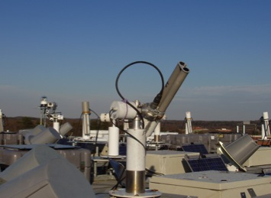
What is Aerosol Optical Depth (AOD?)
The optical depth expresses the quantity of light removed from a beam by scattering or absorption during its path through a medium.
Vertical path optical depth (τ)
Where M represents slant angle:
Sun
Atmosphere
I₀
I
Surface
Notes:
Here I₀ is the intensity of radiation at the source and I is the observed intensity after a given path. As you can see, I am illustrating measurement by a sunphotometer, which is the most direct way of measuring AOD.

Slide 13
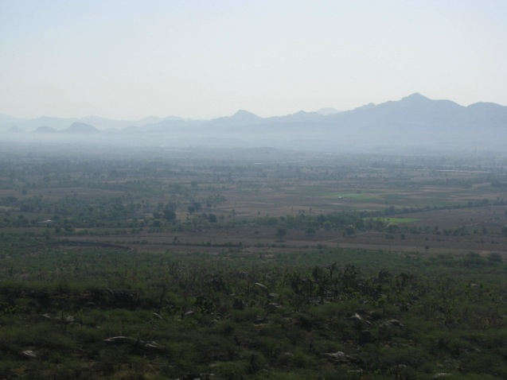
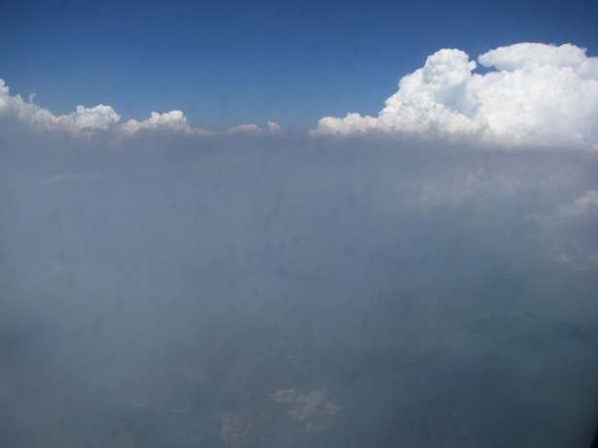
AOD
0.4 over India
AOD is a unitless value.
Sample AOD values:
0.02 - very clean isolated areas.
0.08 – background over ocean
0.2 – fairly clean
0.6 –polluted (Texas in the summer?)
1.5 – heavy smoke/dust event
>3.0 – Sun’s disk obscured!
>2.0 in Brazil
AOD is “spectral”: varies with wavelength
Angstrom Exponent (AE: slope of AOD in visible)
<1.0 = “coarse” sized aerosol
>2.0 = “fine” sized aerosol.

Slide 14
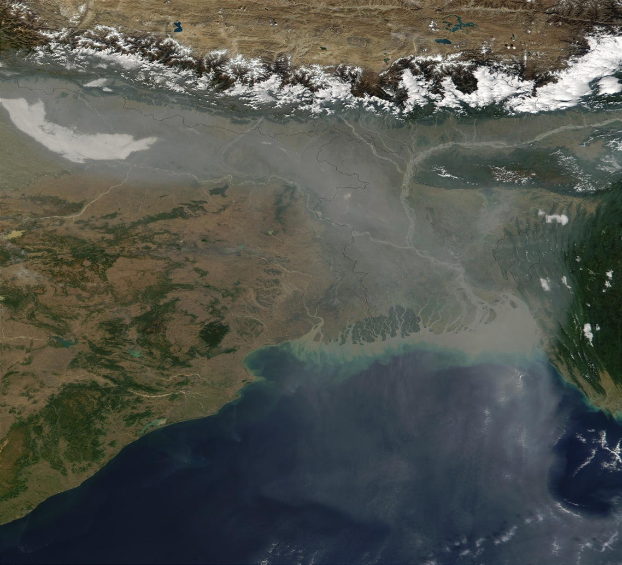
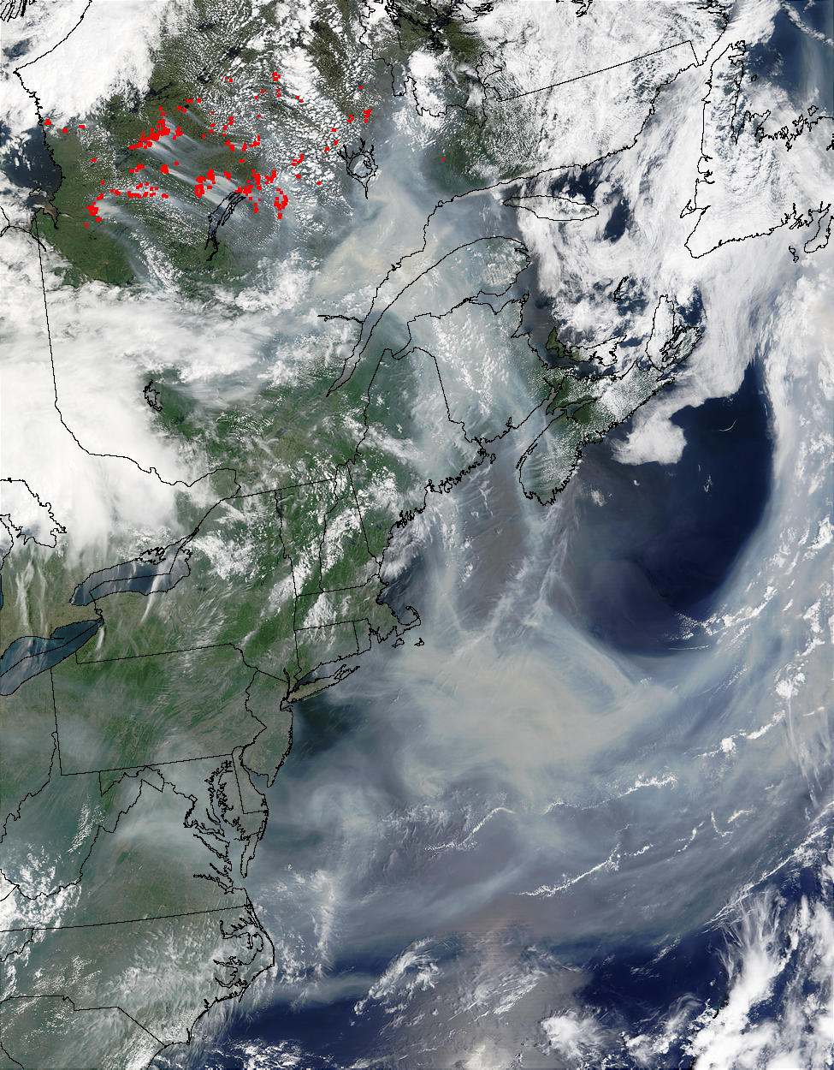
Haze and Smoke from space
Haze over the Ganges/Bay of Bengal (4 December 2001)
Smoke transported over Eastern Canada/USA (8 July 2002)
http://earthobservatory.nasa.gov/

Slide 15
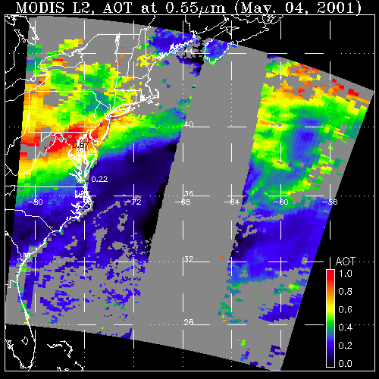
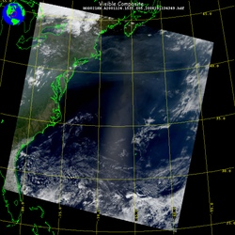
Aerosol retrieval from MODIS
What MODIS observes
Attributed to aerosol (AOD)
May 4, 2001; 13:25 UTC
Level 1 “reflectance”
May 4, 2001; 13:25 UTC
Level 2 “product”
LAND
OCEAN
GLINT
AOD
1.0
0.0
There are many different “algorithms” to retrieve aerosol from MODIS
Dark Target (“DT” ocean and land; Levy, Mattoo, Munchak, Remer, Tanré, Kaufman)
Deep Blue (“DB” desert and beyond; Hsu, Bettenhousen, Sayer,.. )
MAIAC (coupled with land surface everywhere; Lyapustin, Wang, Korkin,…)
Ocean color/atmospheric correction (McClain, Ahmad, …)
Etc (neural net, model assimilation, statistical, … )
Your own algorithm (many groups around the world)
Notes:
DB is separate retrieval team, and is focus of next weeks seminar.

Slide 16
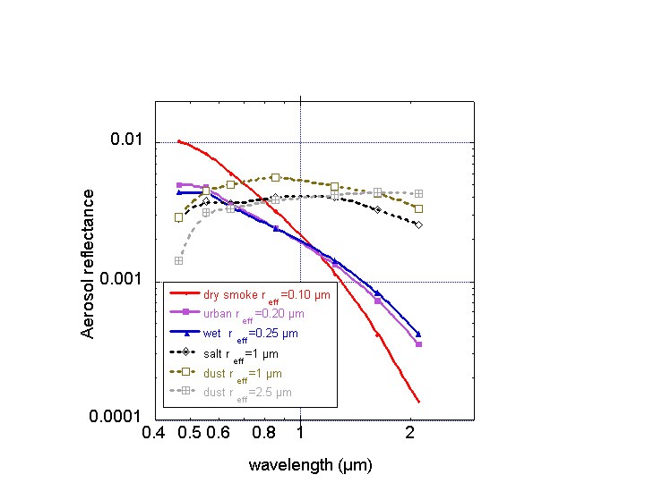
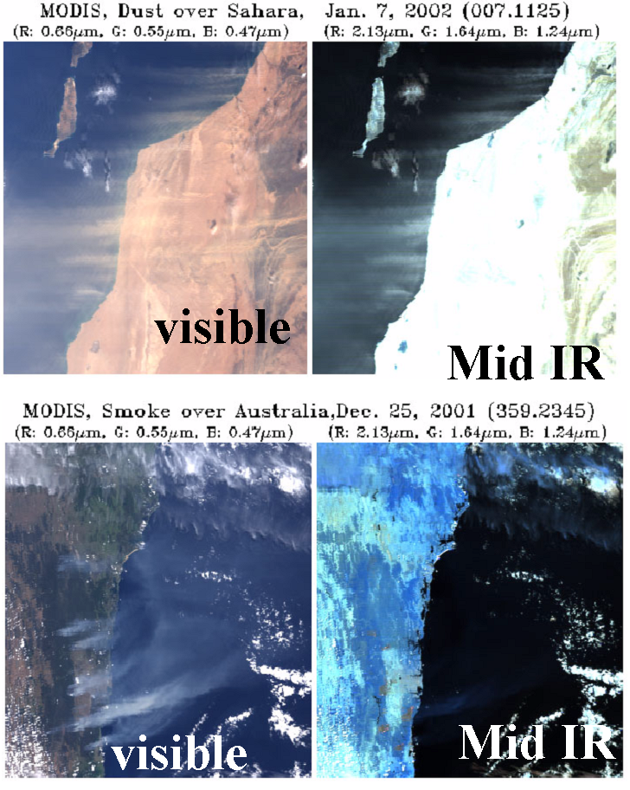
AOD is “spectrally” (wavelength) dependent
(which is primarily dependent on aerosol size)
Coarse
(Dust/Sea salt)
Dust
Fine
(combustion)
Smoke
0.47
0.55
0.86
2.11
0.65
1.24
1.63
“Big” particles (e.g. Dust) reflect in IR “Small” particles (smoke/pollution) do not.
MODIS “Channels”
Used for DT aerosol
Y. Kaufman, D. Tanré

Slide 17

Complicated “Clear sky” TOA Signal
Contributions from:
Gas absorption (O₃, CO₂, etc)
H₂O absorption
Rayleigh (molecular) scattering
Aerosol scattering and absorption
Surface reflection
Atmosphere / Surface interaction
Contamination from neighboring pixels (clouds, etc)
??
Gas + Aerosol scattering
(path radiance)
Indirect Transmission
(adjacency effect)
Multiple Reflection
Direct Transmission
Notes:
So, the key of aerosol retrieval is to make assumptions. All of these assumptions were upgraded/improved for C6.

Slide 18
… And clouds (%@(*%@!)
Developing a good “cloud mask”
Gas + Aerosol scattering
(path radiance)
Indirect Transmission
(adjacency effect)
Multiple Reflection
Direct Transmission

Slide 19
Aerosol algorithm overview
Our aerosol remote sensing retrieval algorithm has multiple phases:
Organizing Level 1B radiance data into 10 km boxes for each 5 minute granule.
Removing distortion (gas absorption, angular effects) from the satellite signal
Deciding whether over “land” or “ocean”
Separating signal (aerosol) from noise (clouds, surface inhomogeneities, instrument issues, etc), includes “cloud masking”
Correctly interpreting the signal to AOD and aerosol size. “the retrieval”
Assigning quality assurance, reporting retrieved, derived, and diagnostic products. “the post-process”

Slide 20
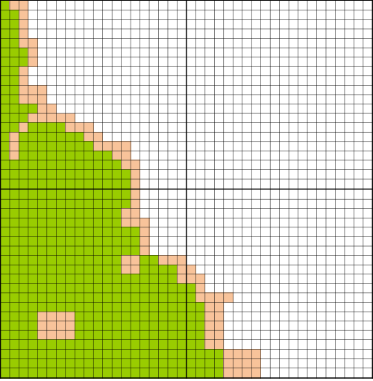
Some basics
<--10 km (20 pixels-)--- >
<--10 km (20 pixels-)--- >
Uses calibrated L1B reflectance data at primarily 500 m resolution.
Splits up the granule into 20x20 boxes (~10 km at nadir).
Corrects for “gas absorption” in each pixel (H₂O, O₃, CO₂).
Decides whether pixel is “land” or “ocean”
  If “all” pixels are ocean (white) then try Ocean retrieval algorithm
  If “any” pixels are land (green), then try Land (must be at least 24)
  Coastal or ambiguous (pale) pixels are Neither.
Does appropriate retrieval
L
O
<--10 km (20 pixels-)--- >
L
N
<--10 km (20 pixels-)--- >
Notes:
This is an illustration of a few 10 km boxes created from the larger granule. White is ocean, Green is land, and pale color is “other” (includes coastal, ephemeris or shallow water, etc).

Slide 21
Cloud Masking
There are many “tests” for clouds in the MODIS scene.
Spatial Variability Tests (clouds appear bumpy)
Visible channel brightness (clouds appear bright)
Visible channel gradients (aerosols appear “colored”)
Cirrus Cloud Removal (high clouds obscure water vapor)
IR tests: (clouds are colder than the surface)

Slide 22
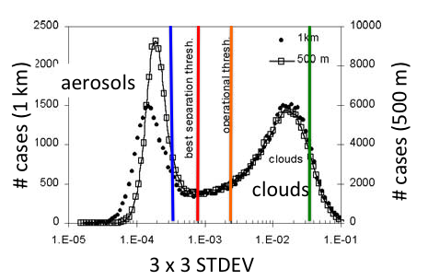
MODIS “aerosol” cloud mask
X
Calculate the standard
deviation of the observed
reflectance in every 3 x 3
set of pixels (at 500 m or 1 km).
If the STDEV > threshold THEN the center pixel is cloudy
aerosols tend to be homogeneous and clouds are fractal
For C6: Slight changes for thresholds and formulas
Martins et al., (2002)
Notes:
This is the main difference between the “aerosol” cloud mask and the standard MxD35 cloud mask. We rely heavily on spatial variability to screen out clouds.

Slide 23
Cloud Masking
There are many “tests” for clouds in the MODIS scene.
Different whether over land or ocean
Could be an entire webinar on its own.

Slide 24
3. Basics of ocean retrieval
MODIS Atmosphere Team C6 Webinar #1

Slide 25
Ocean retrieval: preliminaries
Know that 100% of 20x20 (500 m) pixels are “ocean”
Cloud masking (pixel de-selection) is performed
More pixel de-selection (underwater sediments, glint, etc)
→ We have N* “clear” pixels (not marked with “X”)
Sort N* pixels in ascending order in terms of reflectance magnitude, remove 25% darkest and 25% brightest (residual cloud contamination including shadows)
→ We have N “clear” pixels (not “X” or “Y”)
Calculate average reflectance of N pixels in six channels
  (0.55, 0.65, 0.86, 1.24, 1.63, 2.11 μm)
 |  |  |  |  |  | X
 | X | X | X | X | X |  |  |  |  |  |  |  |  | Y | Y | Y | Y
 | X | X | X | X | X |  |  |  |  |  |  |  |  | Y | Y | Y | Y
 |  | X | X | X | X | X |  |  |  |  |  |  |  | Y | Y | Y | Y |  | X
 |  |  |  |  |  |  |  |  |  |  |  |  |  |  |  |  |  |  | X
 |  |  |  |  |  | Y | Y | Y | Y |  |  |  | X |  |  |  |  |  | X
 |  |  |  |  |  | Y | Y | Y | Y
 |  |  |  | X | X
 |  |  |  | X | X
X |  |  |  | X | X | X |  |  |  |  |  |  |  |  |  | X
X |  |  |  | X | X | X |  |  |  |  |  |  | X | X | X | X | X
X |  |  | X | X | X |  |  |  |  |  |  |  | X | X | X | X | X
X |  |  |  | X | X |  |  |  |  |  |  |  | X | X | X | X | X
 |  |  |  | X | X | X |  |  |  |  |  |  |  | X | X |  | X | X
 |  | Y | Y | Y | Y | Y
 |  | Y | Y | Y | Y | Y |  |  |  |  |  |  | Y | Y | Y
 |  |  |  |  |  |  |  |  |  |  |  |  | Y | Y | Y
MODIS Atmosphere Team C6 Webinar #1

Slide 26
Let’s retrieve aerosol ! (Ocean)
We have removed clouds, found the best pixels, …..
We need to make several assumptions to correctly Infer the aerosol characteristics from the remaining signal.
Assumptions include:
Surface reflectance contribution as function of wind speed (whitecaps + glint + underwater radiance + …)
Ambient aerosol is bi-modal (a superposition of “fine” and “coarse” aerosol)

Slide 27
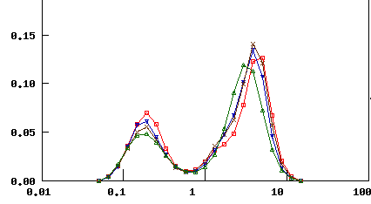
Ambient Size Distribution is approximately bi-lognormal
(e.g., from AERONET)
“coarse” mode
Approximately
“lognormal” shape
dV / dlnr
“fine” mode
Radius , r, (μm)

Slide 28
Physical properties of aerosol
Relationship to optical properties
If we understand:
Size distribution: Assumed as superposition of lognormals, i,
with radii r_{v,i}, standard deviation σ_{i}, and total volume V_{0,i}
For one lognormal mode:
Spectral Complex Refractive index, m_{λ,I}
Shape distribution: Spherical? Spheroids?
These aerosol properties are directly linked to spectral scattering / absorption (extinction) properties through Mie theory (if spherical), or other theory (e.g. T-matrix for collection of spheroids).
We can calculate spectral aerosol “reflectance” for a variety of aerosol types. These are our LOOKUP TABLES!

Slide 29
Aerosol “models” over ocean
Are represented by theoretical “modes”
Fine (Small) Mode | Refractive Index λ=0.47-->0.86μm | r_{g} | σ | r_{eff} | Comments
1 | 1.45-0.0035i | 0.07 | 0.40 | 0.10 | Water Soluble
2 | 1.45-0.0035i | 0.06 | 0.60 | 0.15 | Water Soluble
3 | 1.40-0.0020i | 0.08 | 0.60 | 0.20 | Water Soluble with humidity
4 | 1.40-0.0020i | 0.10 | 0.60 | 0.25 | Water Soluble with humidity
Coarse (Big) Mode | Refractive Index λ=0.47-->0.86μm | r_{g} | σ | r_{eff} | Comments
5 | 1.35-0.001i | 0.40 | 0.60 | 0.98 | Wet sea salt type
6 | 1.35-0.001i | 0.60 | 0.60 | 1.48 | Wet sea salt type
7 | 1.35-0.001i | 0.80 | 0.60 | 1.98 | Wet sea salt type
8 | 1.53-0.003i (0.47) 1.53-0.001i (0.55) 1.53-0.000i (0.66) 1.53-0.000i (0.86) | 0.60 | 0.60 | 1.48 | Dust-like type
9 | 1.53-0.003i (0.47) 1.53-0.001i (0.55) 1.53-0.000i (0.66) 1.53-0.000i (0.86) | 0.50 | 0.80 | 2.50 | Dust-like type
ATBD

Slide 30
Look Up Tables - LUT
Radiative transfer code is time consuming.
To run more efficiently we make use of a set of pre-computed tables for the various sets of possible angles and amounts of aerosol.
ρ_{λ}ª,T_{λ}, s_{λ}: (path radiance, transmission, backscattering)
Combination of Rayleigh + Aerosol
ρ_{λ}^{s}: (surface reflectance)
  Combination of foam / whitecaps (assuming wind speed) + water leaving radiance” (nonzero at 0.55 μm only)

Slide 31

MODIS aerosol retrieval over ocean
Find one coarse mode and
one fine mode
that combine to match the
observed spectral reflectances
reflectance
wavelength
0.10
0.20
1.0
2.0
Radius (µm)

Slide 32
MODIS Ocean Aerosol Retrieval
Remote Sensing of Spectral Aerosol Properties: A Classroom Experience
(Levy and Pinker, BAMS, 2007)

Slide 33
MxD04 Aerosol Products over Ocean
“Effective_Optical_Depth_Average_Ocean”
Retrieved AOD at 7 wavelengths
(.47, .55, .66, .86, 1.24, 1.63, 2.13 μm)
“Optical_Depth_Ratio_Small_Ocean_0.55*”
Fraction of Fine Mode AOD at 0.55
“Optical_Depth_Small_Average_Ocean”
AOD * Fine Mode Ratio
There are many other parameters, some derived, some diagnostic. See documentation for details!
AOD
Fine Mode
Fraction
Fine
AOD

Slide 34
Quality Assurance is Extremely Important!!
QA indicates the confidence in the quality of the retrieval.
Quality_Assurance_Ocean
Scale is 0 (low) – 3 (high)
Recommend: Ocean QA > 0
Main Factors:
Number of pixels “N” (out of 400)
Error fitting (difference between observation and LUT)
How close to glint?
Are retrieved quantities “realistic?”
Is aerosol signal so “low” that aerosol properties cannot be retrieved?
Etc

Slide 35
4. Basics of land retrieval
MODIS Atmosphere Team C6 Webinar #1

Slide 36
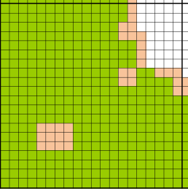
Land retrieval: preliminaries
Know that at least some % of 20x20 (500 m) pixels are “land”
Cloud masking (pixel de-selection) is performed
More pixel de-selection (inland water, surface heterogenitity, snow, ice, etc)
→ We have N* “clear” pixels
Sort N* pixels in ascending order in terms of reflectance magnitude, remove 20% darkest and 50% brightest (residual cloud contamination including shadows, biasing towards “dark” targets)
→ We have N “clear” pixels
Calculate average reflectance of N pixels in five channels
  (0.47, 0.65, 0.86, 1.24, 2.11 μm)
MODIS Atmosphere Team C6 Webinar #1

Slide 37
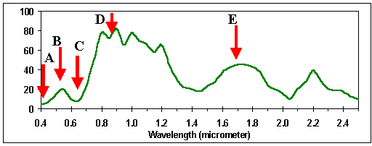
Structure of land retrieval
We need to make several assumptions to infer the aerosol characteristics from the reflectance signal (average of N pixels)
Dark targets: Surface reflectance contribution is related spectrally
Ambient aerosol is multi-modal (a superposition of “fine” and “coarse” aerosol models, each are bi-modal).
Aerosol type is related to when in the year, and where in the world. We have to assume aerosol type
Vegetation reflectance:
ρ^{s}_{0.66} ≈ 0.55ρ^{s}_{2.1}
ρ^{s}_{0.47} ≈ 0.50ρ^{s}_{0.66}
Depends on
ρ_{0.86 ,} ρ_{1.2} , ρ_{2.1} and Θ

Slide 38
Retrieval: Inversion over “dark” targets
Calculate optical loading τ and weighting η of fine-dominated model (to total τ), combined with the surface reflectance ρ_{s}, that best matches the observed spectral reflectance.
0.55 μm
coarse
combo
reflectance
fine
surface
wavelength
Cartoons stolen from L. Remer
Fine
Coarse
0.10
0.20
1.0
2.0
Radius (µm)

Slide 39
MxD04 Aerosol Products over Land
“Corrected_Optical_Depth_Land”
Retrieved AOD at 4 wavelengths
(0.47, 0.55, 0.66, 2.11 μm)
“Optical_Depth_Ratio_Small_Land”
Fraction of Fine Model AOD at 0.55
There are many other parameters, some derived, some diagnostic. See documentation for details!
AOD
Fine Mode
Fraction

Slide 40
Quality Assurance is Extremely Important!!
QA indicates the confidence in the quality of the retrieval.
Quality_Assurance_Land
Scale is 0 (low) – 3 (high)
Recommend: Land QA ≥ 1
Main Factors:
Number of pixels “N” (out of 400)
Error fitting (difference between observation and LUT)
Are retrieved quantities “realistic?”
Is aerosol signal so “low” that aerosol properties cannot be retrieved?
Is surface “brighter” than desirable?
Etc

Slide 41
5. Products and “validation”

Slide 42
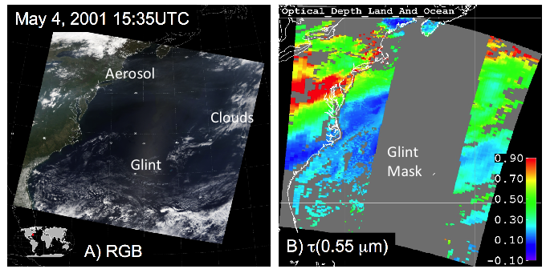
aerosol retrieval combined land/ocean
Glint
Mask

Slide 43
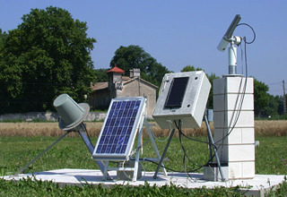
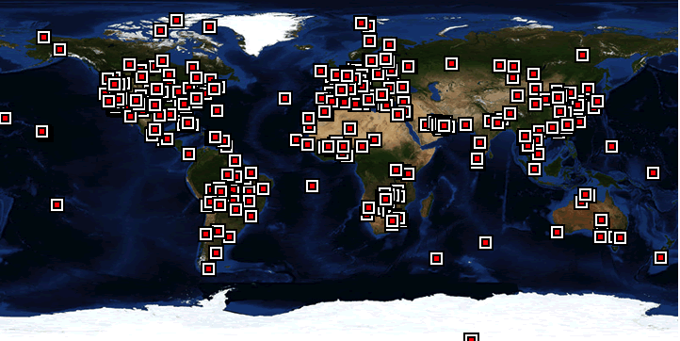
Can we believe the results?
Self Consistency
  Visual check
  No Angle dependency
  Valid cloud mask
  Land / Ocean continuity
Comparison with “ground truth” (e.g. sunphotometer)
50 km
10 km
10 km
50 km
AERONET: τ_{ε} ~ 0.02
A “global” network

Slide 44
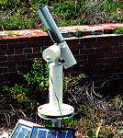
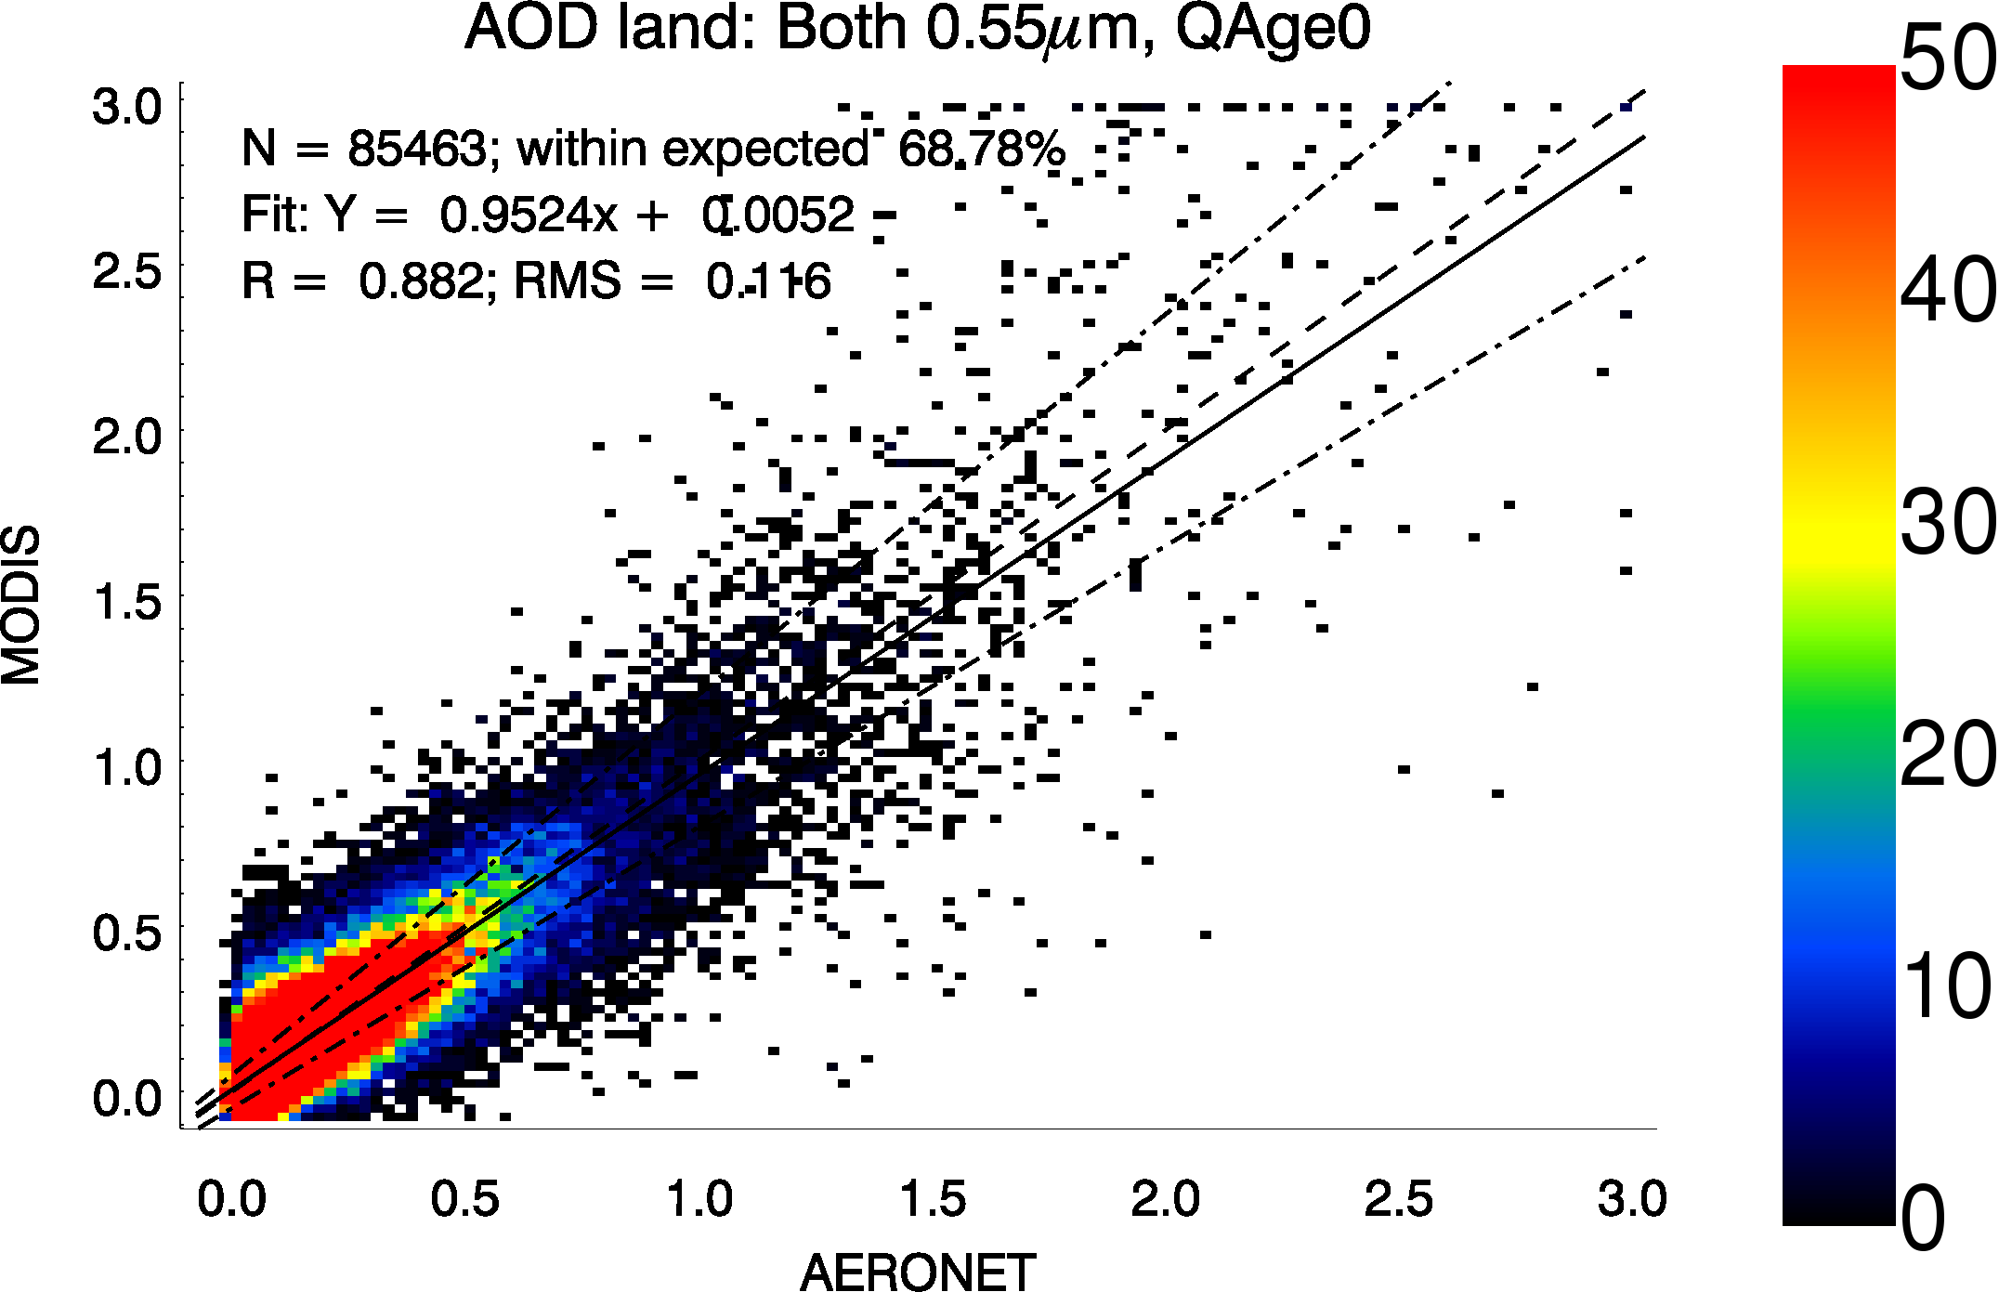
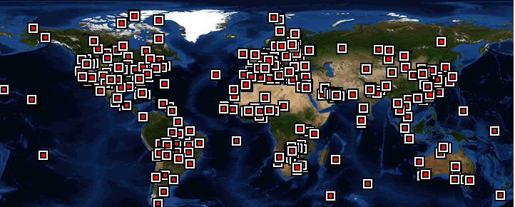
Validation: expected error for C5 data
May 4, 2001; 13:25 UTC
Level 2 “Granule”
First steps:
Pictures look good
Compare both land and ocean products to AERONET, separately
Validation: 66% are within “Expected Error” (EE) defined as
  Land: ±(0.15τ + 0.05)
  Ocean: ±(0.05τ + 0.04)
0.67
LAND
0.22
AOT
1.0
0.0
OCEAN GLINT MASK
LAND
AERONET: Level 2 (Quality Assured)
Levy et al., ACP 2010

Slide 45
6. MODIS Collection 6!
Published in Atmospheric Measurement Techniques (open access journal):
Levy, R. C., Mattoo, S., Munchak, L. A., Remer, L. A., Sayer, A. M., Patadia, F., and Hsu, N. C., “The Collection 6 MODIS aerosol products over land and ocean”, Atmos. Meas. Tech., 6, 2989-3034, doi:10.5194/amt-6-2989-2013, 2013.
Many updates for C6, including calibration

Slide 46
Aerosol algorithm overview
Our aerosol remote sensing retrieval algorithm has multiple phases:
Organizing Level 1B radiance data into 10 km boxes for each 5 minute granule.
Removing distortion (gas absorption, angular effects) from the satellite signal
Deciding whether over “land” or “ocean”
Separating signal (aerosol) from noise (clouds, surface inhomogeneities, instrument issues, etc), includes “cloud masking”
Correctly interpreting the signal to AOD and aerosol size. “the retrieval”
Assigning quality assurance, reporting retrieved, derived, and diagnostic products. “the post-process”
For Collection 6, all aspects of retrieval algorithm were fine tuned and upgraded.

Slide 47
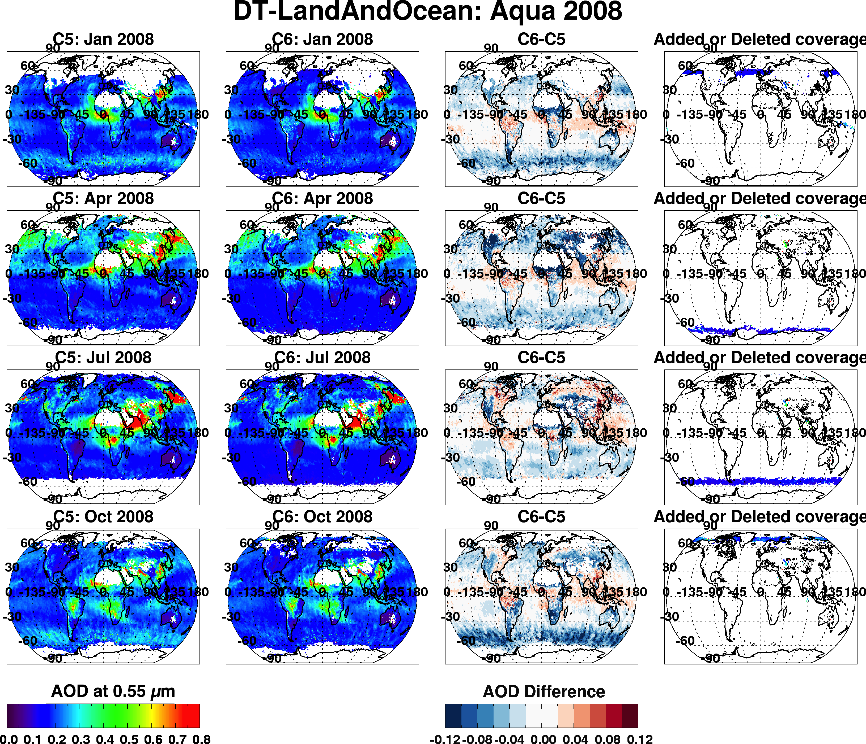
Overall changes (C6 vs C5): Aqua, 2008
Jan
Apr
Jul
Oct
0.0 0.8
-0.1 0.0 0.1

Slide 48
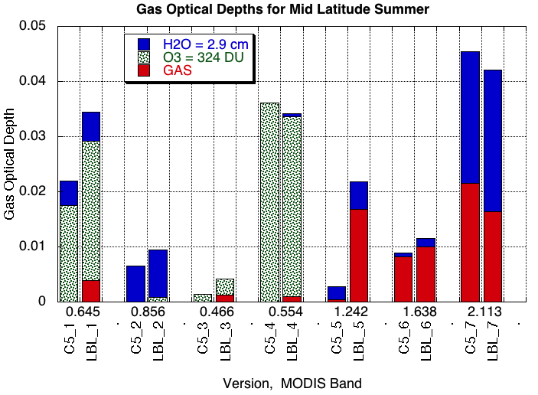
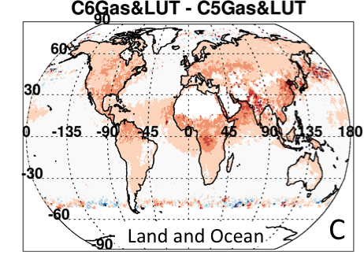

Correction for gas absorption and Rayleigh optical depth
Although in atmospheric “windows”, there is still absorption from: water vapor, ozone, CO₂ & other gases.
Absorption of these gases varies by wavelength! And can be up to optical depths of 0.05! Must account for accurately!
For C6:
Use modern Radiative Transfer code to account for gas absorption
Recalculate center wavelengths and Rayleigh optical depths
Upshot: global AOD increased by 0.02

Slide 49
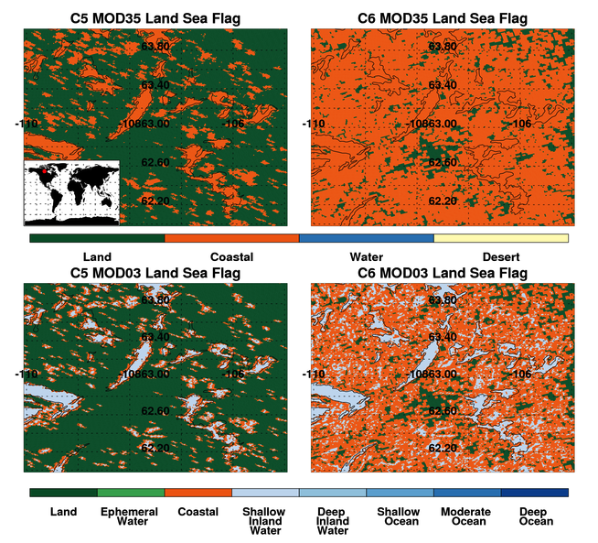
Land/Sea Flag Land or Ocean?
If all pixels in the 10 x 10 kilometer box are ocean the Ocean Algorithm is used.
If any land pixels are observed in the 10 Km box the Land Algorithm is used.
The MOD35 cloud mask product is used to determine if each pixel is land or ocean. However this MOD35 is based on MOD03, which is further based on a global land/sea mask.
That land/sea mask was changed!
Upshot: no “global” change, but big local
changes. Also new retrievals over inland
water bodies.

Slide 50
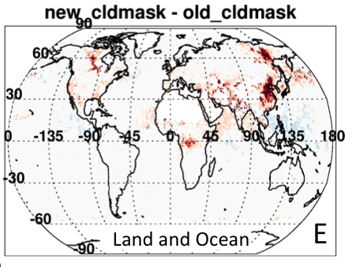
Cloud Masking
There are many “tests” for clouds in the MODIS scene.
Spatial Variability Tests (clouds appear bumpy)
Visible channel brightness (clouds appear bright)
Visible channel gradients (aerosols appear “colored”)
Cirrus Cloud Removal (high clouds obscure water vapor)
IR tests: (clouds are colder than the surface)
Upshot: no “global” change, but big local
changes. Especially big over Asia, and tropical cirrus regions.

Slide 51
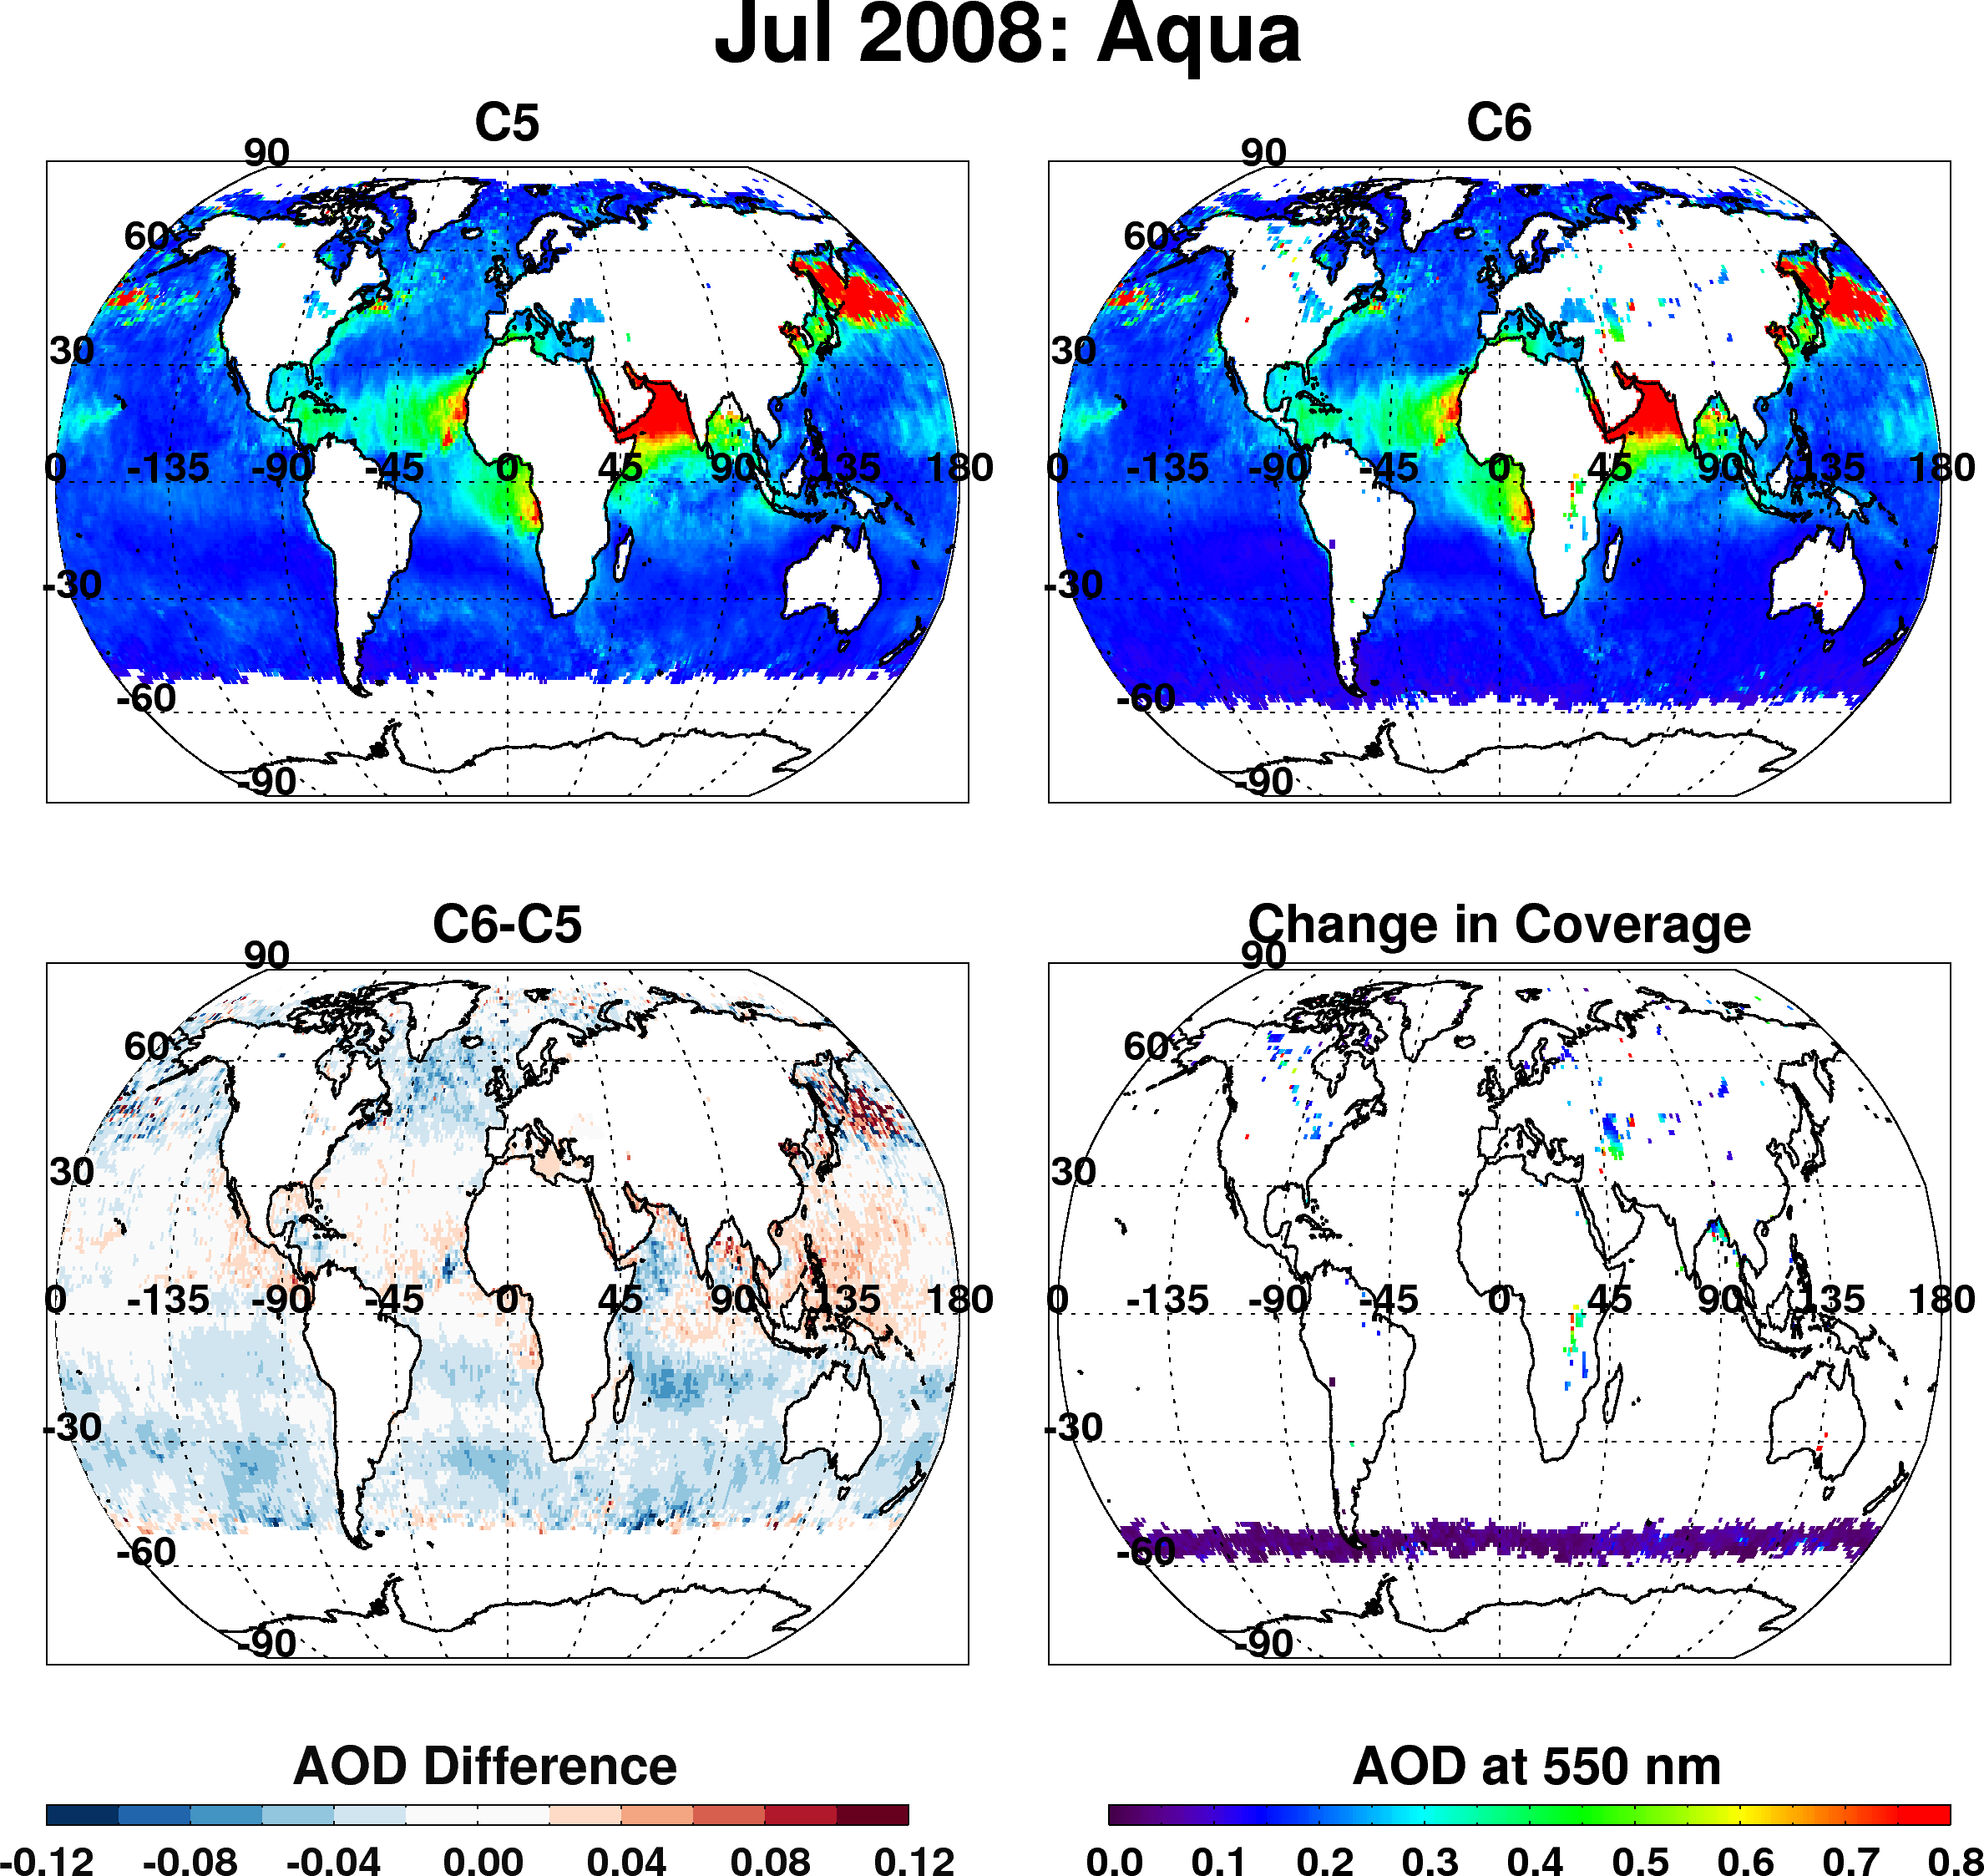
Dark target over ocean
Overall changes to products (Aqua, Jul 2008)
Overall decrease of AOD in mid-latitudes
Strong decrease in “roaring 40s” (even stronger in other months)
Overall increase in tropics
“New” coverage over inland lakes
Increase in coverage toward poles

Slide 52
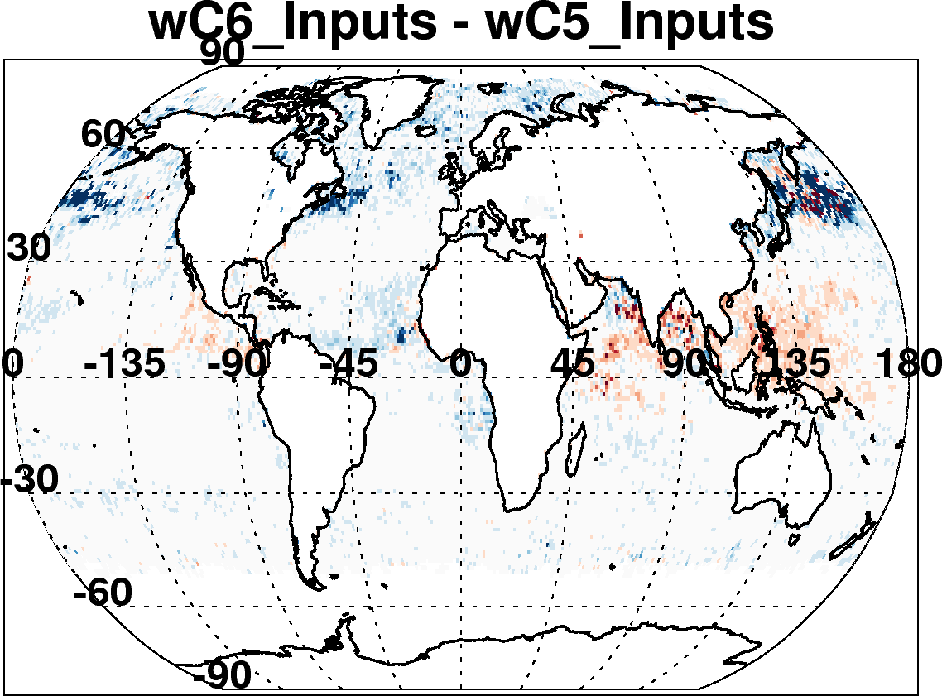
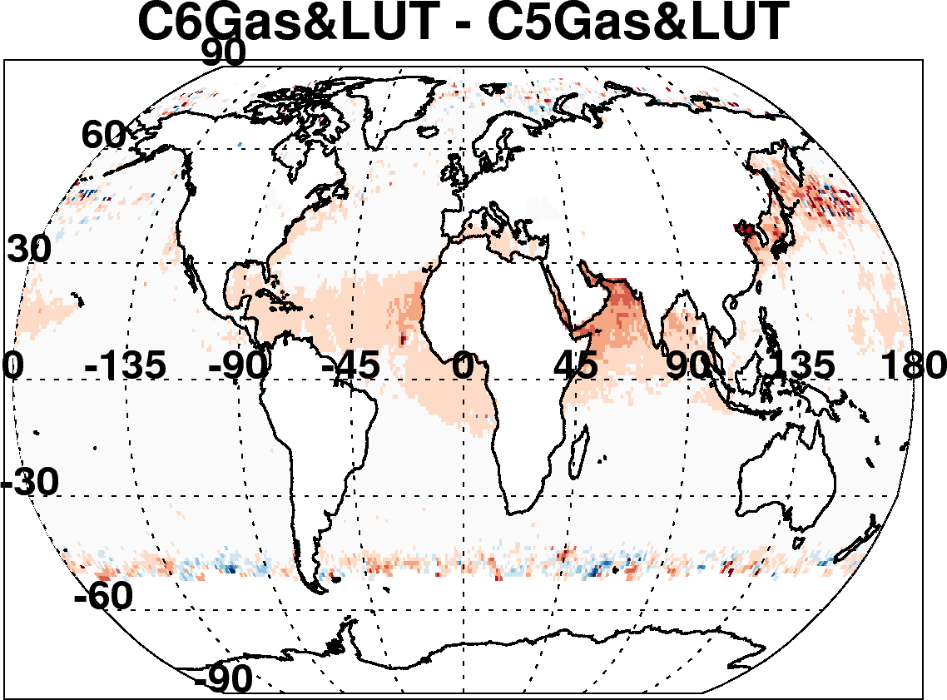
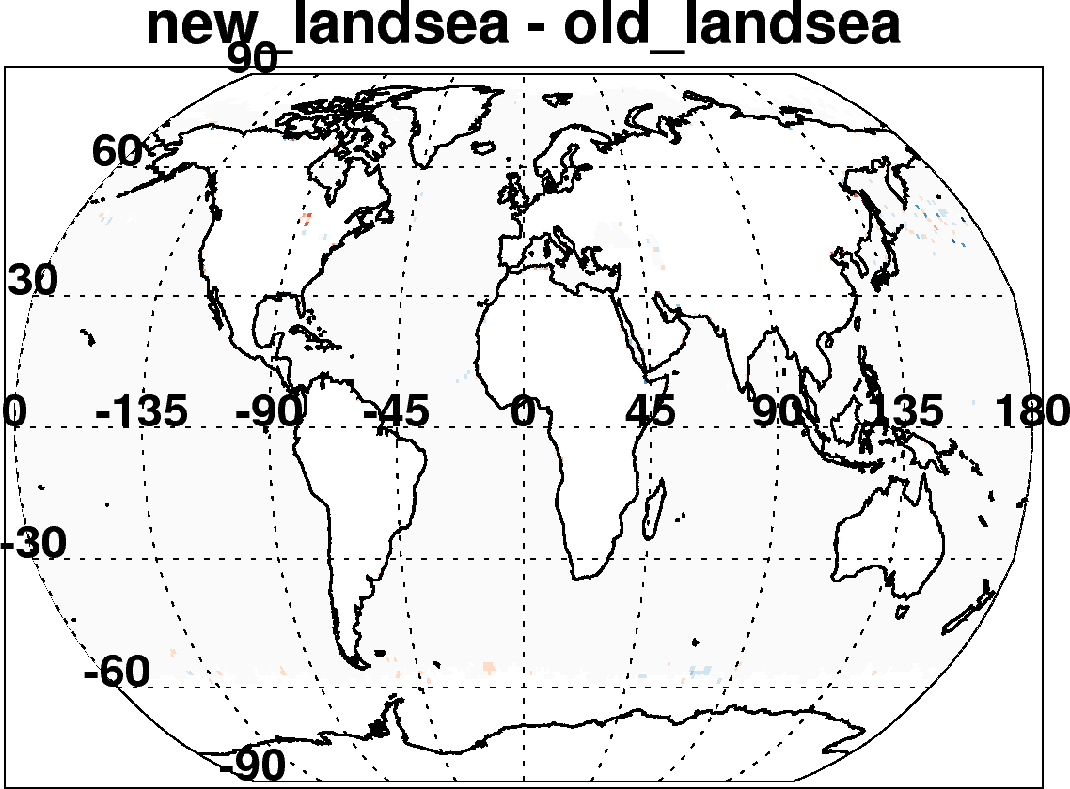
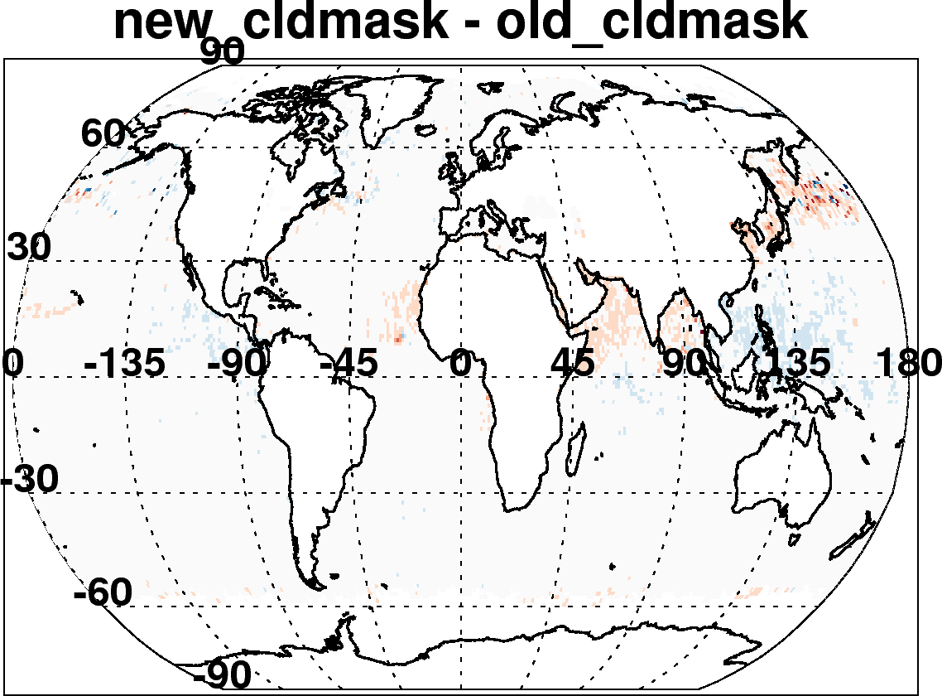
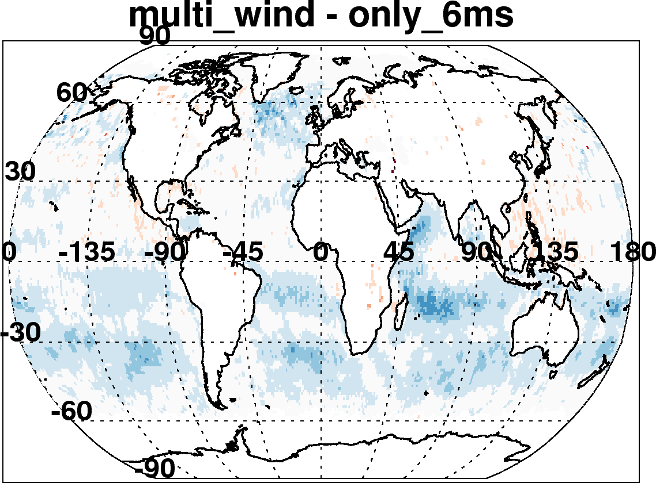

C6-C5 ocean: Due to many incremental changes
(Aqua, July 2008)
New reflectance, geo-location inputs, Wisconsin cloud mask
Updated radiative transfer
Re-define land and sea
Account for wind speed impact on surface
Improved cloud mask
Also changed “Quality Assurance” Filtering
Changed aerosol definitions of land and sea
Etc

Slide 53
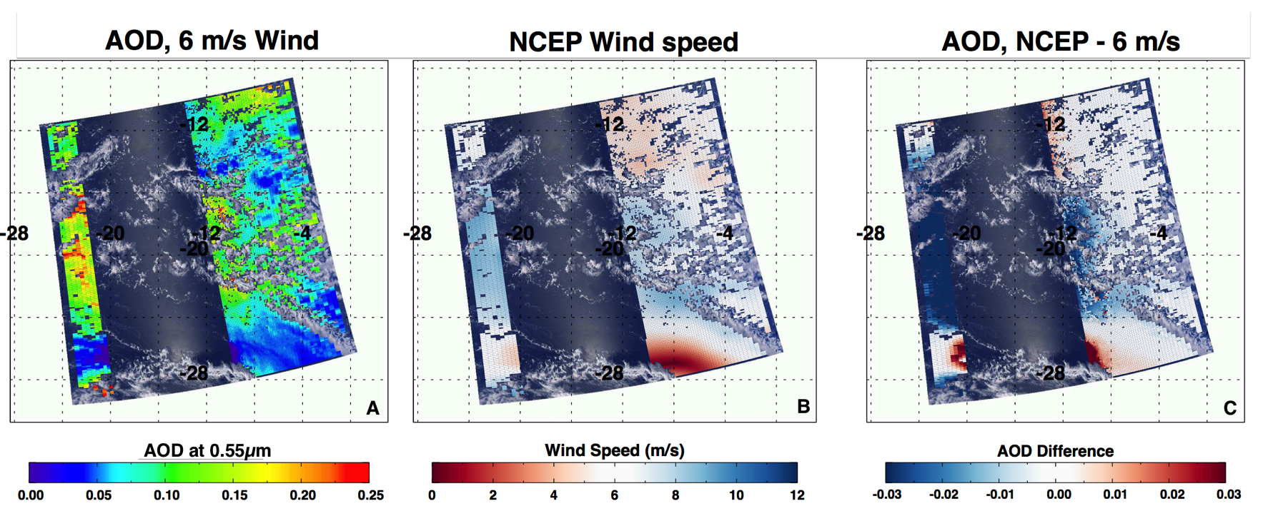
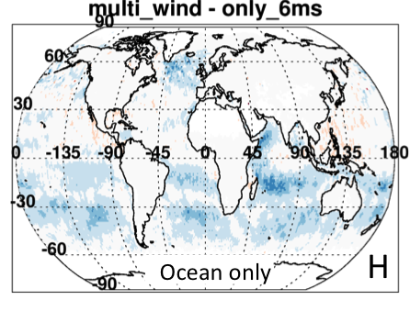
Over ocean: Wind speed dependence
Upshot: reduced AOD by 0.01 over all ocean
Especially important in Southern Hemisphere

Slide 54
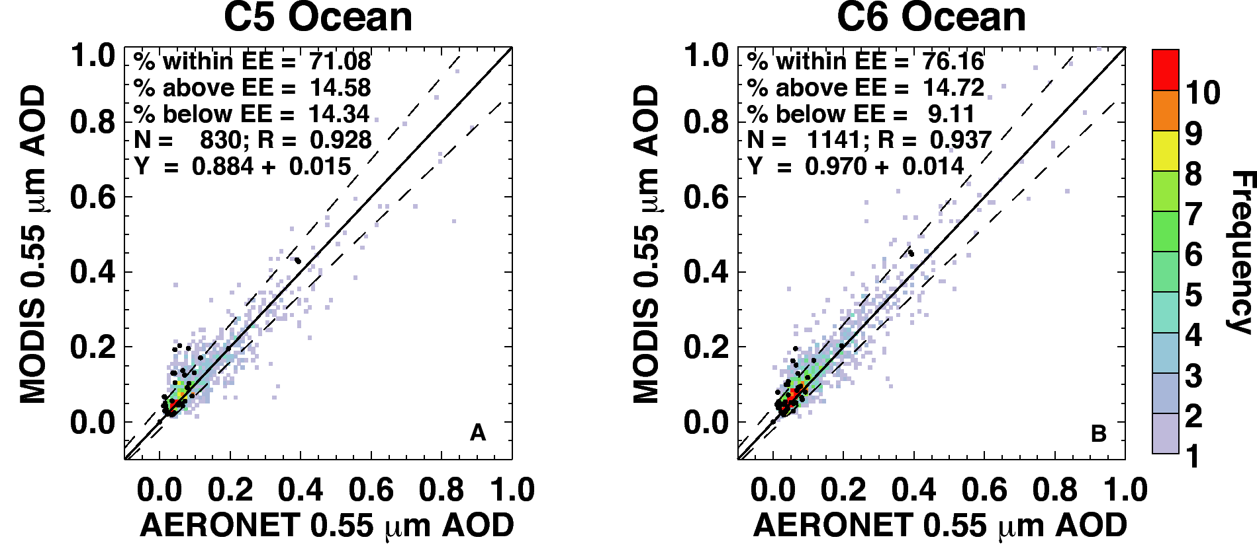
Comparison with AERONET and MAN
Aqua for 8 months (Jan + July, 2003, 2008 and 2010; Apr + Oct 2008).
Overall, not much change over ocean (slope, intercept, correlation)
But 30% more valid points to compare with (1141 versus 830).
AERONET are gray and colored, MAN are black dots

Slide 55
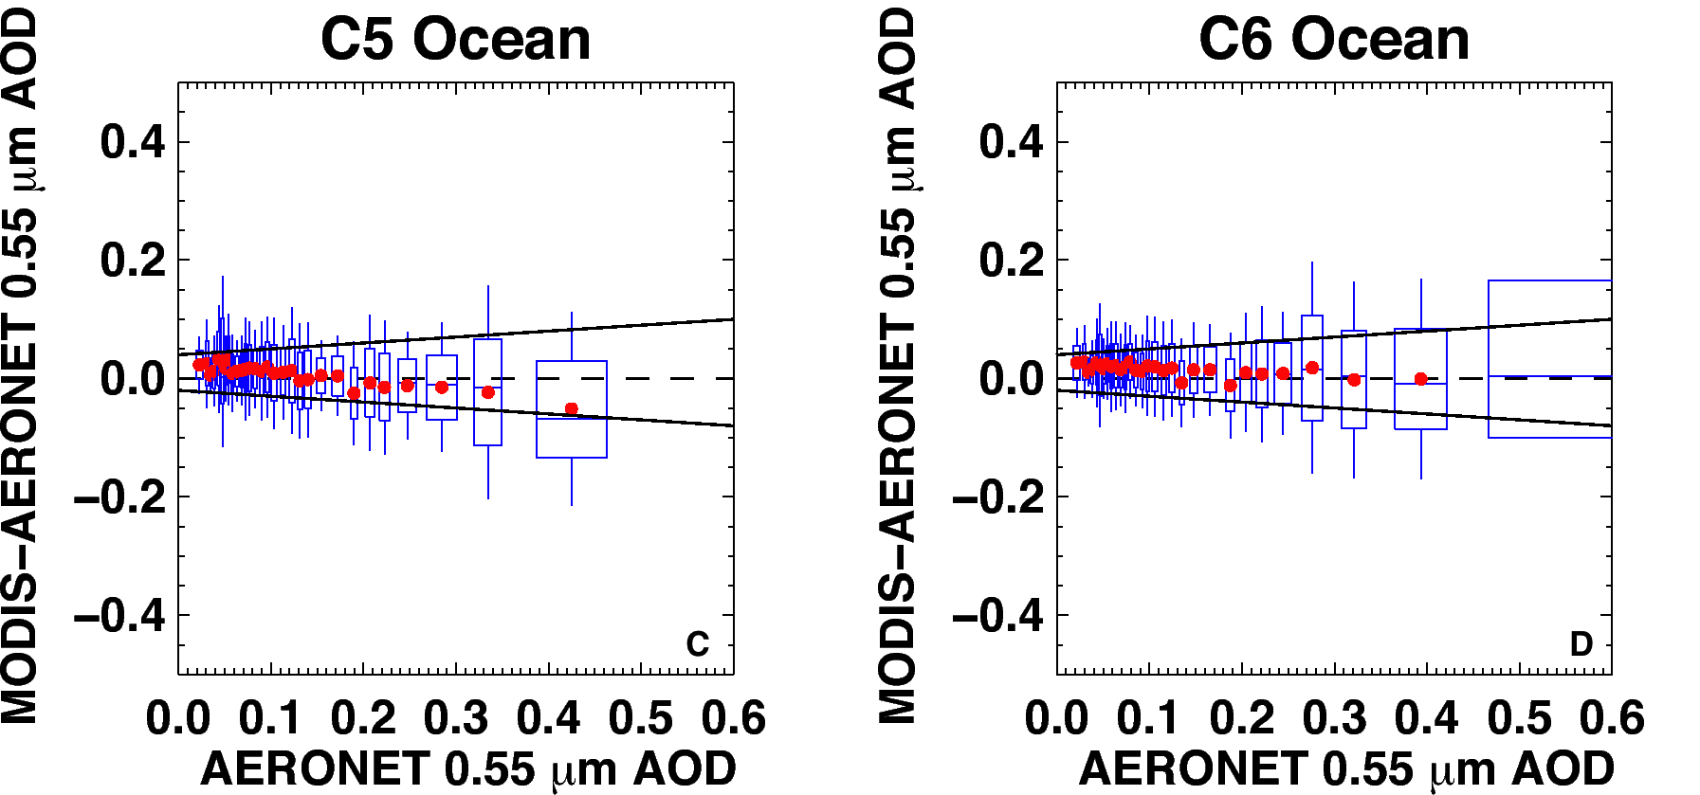
Better way to see MODIS improvement
MODIS error (MODIS–AERONET) versus AERONET; zero “error” is dashed line
Boxes represent middle 67% of each dataset, whiskers are middle 95% of MODIS-AERONET
Solid lines are “expected error” (EE) envelope; note asymmetry (new definition for C6).
Note that in C6, that the MODIS error is within EE for nearly all bins of AOD
C5 EE = ±(0.03 + 5%). C6 EE = (-0.02 – 10%), (+0.04 + 10%) )
Less overall “bias” in C6.
We now have validation for all years of Aqua data

Slide 56
SDSs over ocean
Notes:
You can’t read this, but here are SDSs over ocean within the MxD04_L2 file, pulled out from the AMT paper. Most SDSs are same from C5, but there are some that are renamed (e.g. PSML003_Ocean”, and others that have revised dimensions.

Slide 57
Aerosol over land

Slide 58
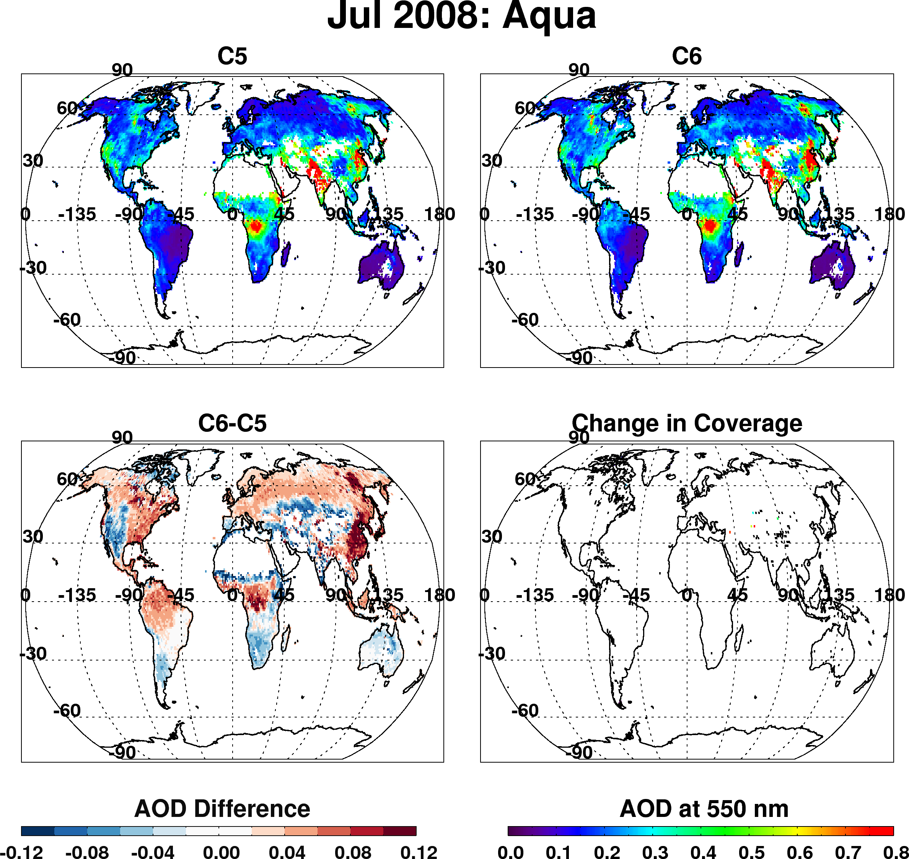
Dark target over land
Overall changes to products (Aqua, Jul 2008)
Overall decrease of AOD in semi-arid
Overall increase over vegetation
Strong increase over Eastern Asia
Slight change in coverage here and there

Slide 59
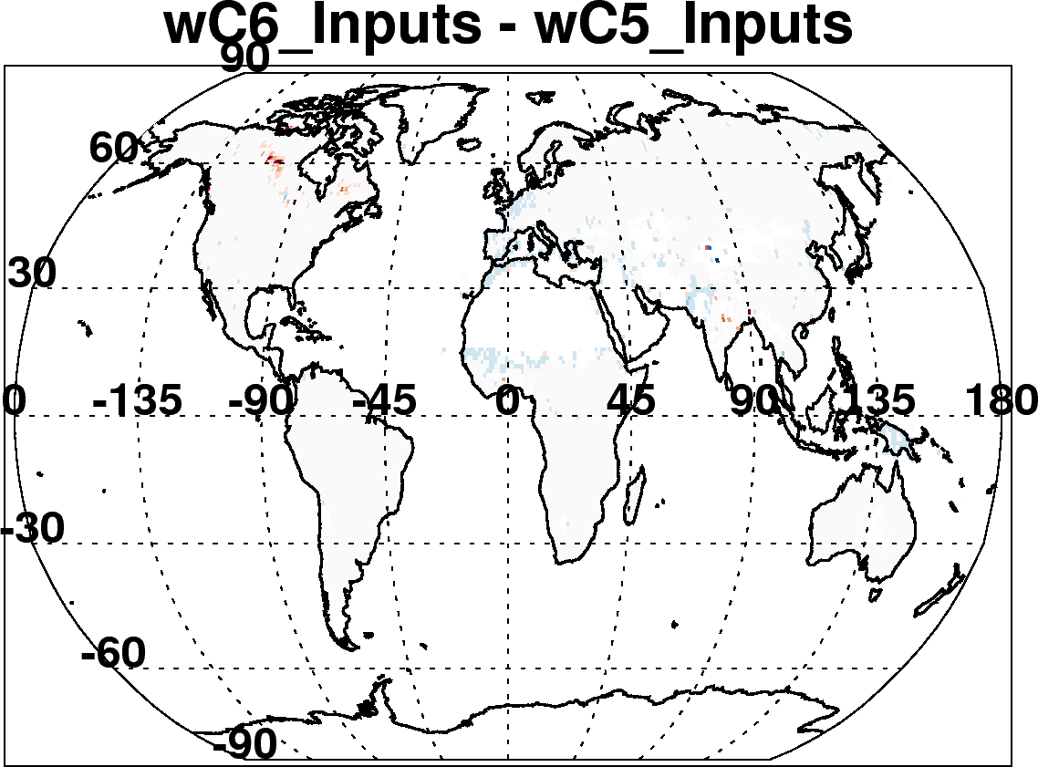
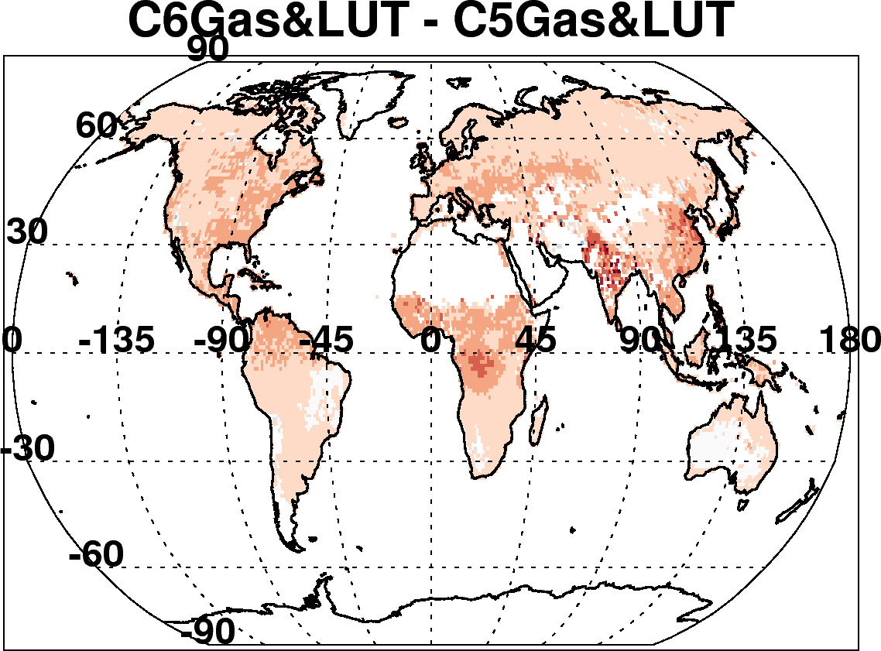
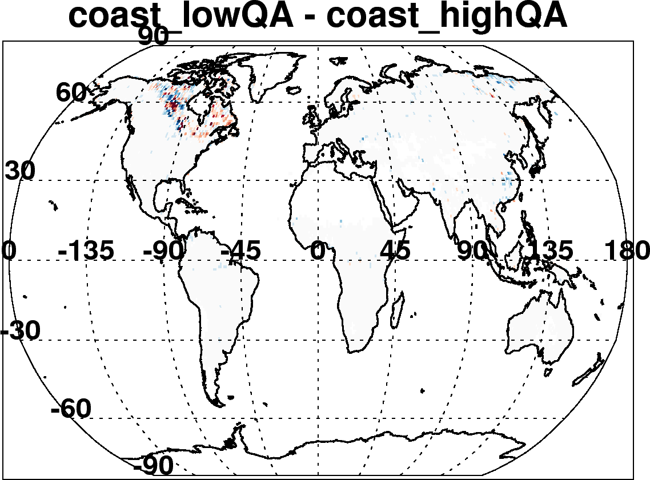
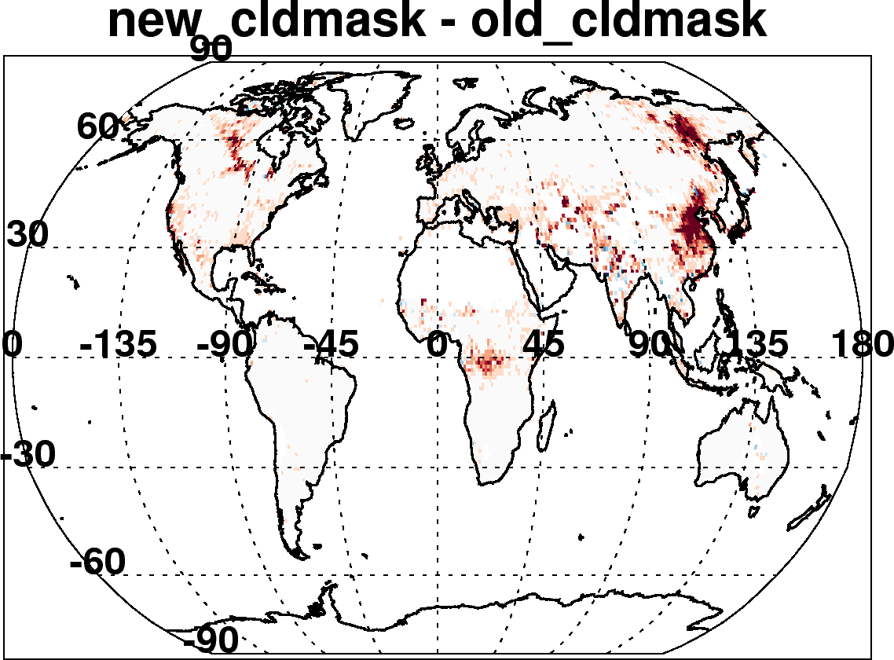
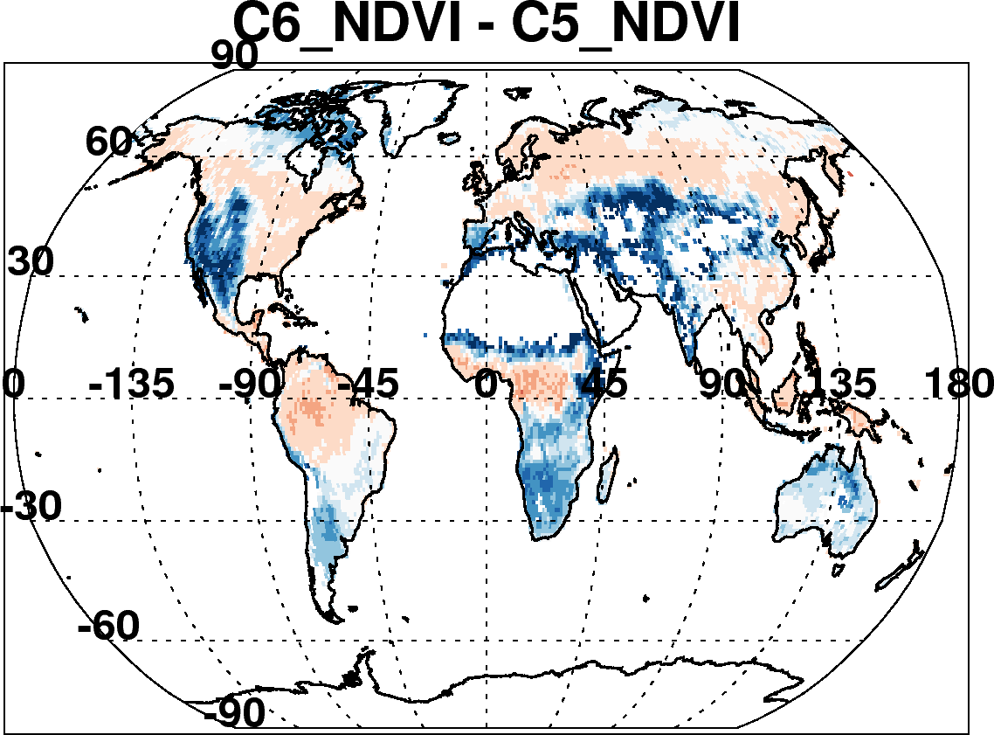
C6-C5 land: Due to many incremental changes
(Aqua, July 2008)
New reflectance and geo-location inputs
Updated radiative transfer
Re-define land and sea
Improved cloud mask to detect smoke
Fixed surface reflectance dependence on TOA NDVI
Also changed “Quality Assurance” Filtering
Changed aerosol definitions of land and sea
Etc
This was a major bug!

Slide 60
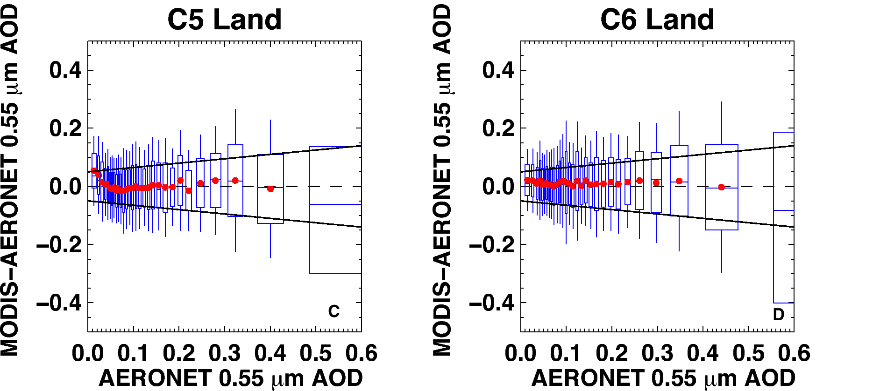
Preliminary comparison with AERONET
(8 months of Aqua data)
MODIS error (MODIS–AERONET) versus AERONET; zero “error” is dashed line
Boxes are middle 67% of dataset, whiskers are middle 95% of MODIS-AERONET
Solid lines are “expected error” (EE) envelope; no asymmetry
C6 MODIS error is within EE for nearly all bins of AOD (even at low values)
C5 EE = ±(0.05 + 15%)). Keep definition for C6.
Note, we have 10+ years of validation now with Aqua

Slide 61
SDSs over land
Notes:
You can’t read this, but here are SDSs over land within the MxD04_L2 file, pulled out from the AMT paper. Most SDSs are same from C5, but there are some that are renamed (e.g. “Aerosol_Cloud_Fraction”, and others that have revised dimensions. A few are deleted (eg. The Angstron exponent and optical depth small land) because there is no quantitative value to them. The Path radiance and critical reflectance products were also deleted due to no known users.

Slide 62
SDSs combined land/ocean
We continue the idea of having “joint” SDSs that take the best of both land and ocean. There are two versions:
  Image_Optical_Depth_Land_And_Ocean: populated for all pixels in which either land or ocean made a retrieval.
    This is intended for imagery with fewer holes
  Optical_Depth_Land_And_Ocean: populated for pixels that meet Quality Assurance criteria
    This is intended for more scientific integrity
    For land: QA = 3 (only)
    For ocean: QA ≥ 1 ( =1, 2 or 3).
  Land_Sea_Flag: This new SDS integer describes whether retrieval over land or ocean (or neither).
  Land_Ocean_Quality_Flag: This new SDS integer repeats the QA for land and ocean, but in an integer form (no decoding bits and bytes).
Notes:
These are described in the AMT paper

Slide 63
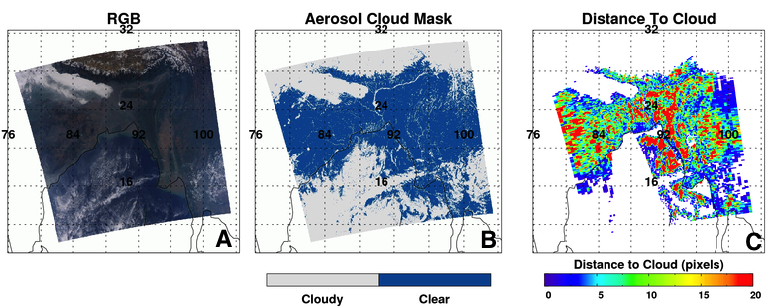
What else for C6 Level 2?
Diagnostic SDSs (wind speed, topographic elevation, etc)
“Cloud mask”, “distance to nearest cloud” (these are at native 500 m resolution).
Changes to SDS names

Slide 64
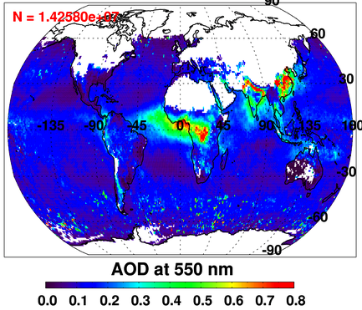
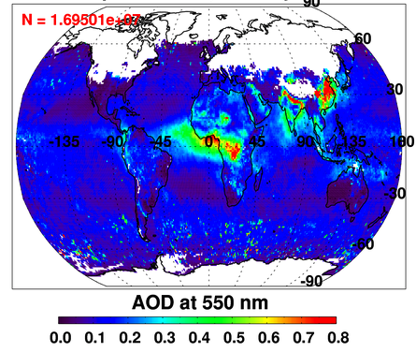
Deep Blue/Dark Target Merge:
Dark Target AOD
DeepDark AOD
Merging deep blue & dark target produces best global coverage
Deep blue is land-only; need dark target for oceans
Deep blue introduces coverage over Australian outback, Sahara desert
  and Arabian peninsula
Still no coverage over snow (see: most of Northern Hemisphere).
      LOOKS REASONABLE, Subject of next week’s webinar?

Slide 65
7. For Level 3
MODIS Atmosphere Team C6 Webinar #1

Slide 66
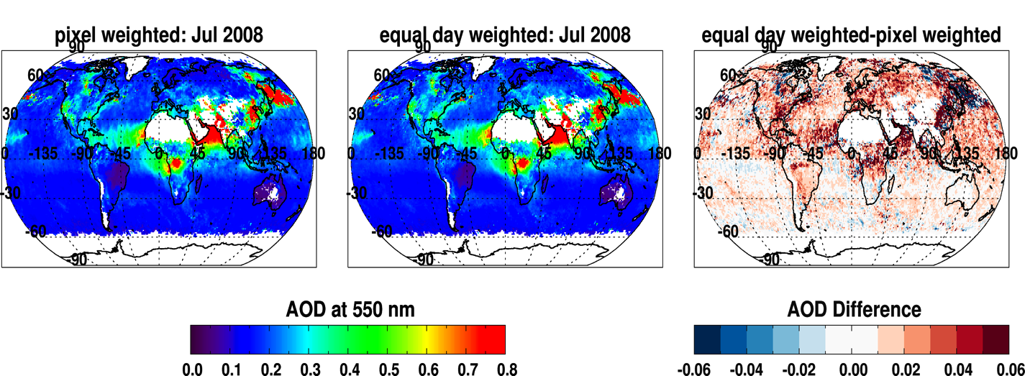
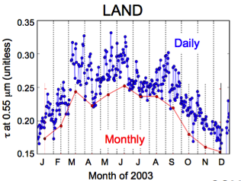
Changes to Level 3 (MxD08_M3)
C5
C6
C6-C5
In C5, averaging daily data did not look like monthly data (left, from Giovanni web application)
C5 monthly was “pixel weighted”. A day with 100 retrieved pixels was worth 10 times more than one with 10. It was clear-sky biased.
C6 monthly is “equal day” weighted. If at least five pixels in a day, than that day counts.
→ Increases monthly mean AOD over land, and ocean. Less clear sky biased?
C5

Slide 67
Changes to Level 3 (MxD08_M3)
Removed some SDSs that averaging makes no sense:
This is especially true of “intrinsic” aerosol parameters
    e.g., Angstrom exponent (AE), fine mode weighting (FMW)
    If a user wants to derive mean AE, they can use spectral AOD and calculate their own AE.
    Added joint histograms for some SDSs
    e.g., Angstrom Exponent versus AOD.

Slide 68
8. Terra versus Aqua
(also why Terra hasn’t been produced yet)

Slide 69
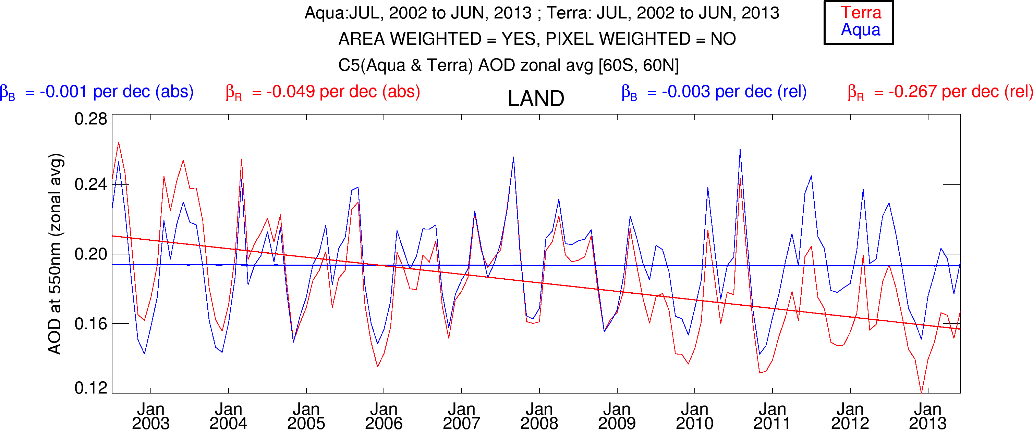

Trends in Collection 5
Over land, Terra decreases (-0.04/decade), Aqua constant
Terra / Aqua divergence is the same everywhere on the globe!
In NH, observations are 1.5 hours apart, while SH are 4.5 hours
So, probably not due to diurnal cycle of aerosol

Slide 70




Why? MODIS reflectance over desert sites: C5
Collect clear-sky MODIS data over desert sites
Develop site-specific BRDF from first 3 years of mission
MCST found that “observed” reflectance diverged from BRDF modeled reflectance over time
Many bands were affected, but for DT aerosol, these included 0.47, 0.55, 0.65 and 0.86 μm bands.
Terra much worse than Aqua
MCST was able to “de-trend” the observations and
Create a new L1B dataset for C6.
Observed Reflectance / BRDF Modeled
desert test sites
C5 reflectance
C6 reflectance
MCST (Sun, Xiong et al)
Notes:
70

Slide 71




Impact to “observed” reflectance
“Global” Aqua changes in visible bands by -0.001 or less
“Global” Terra changes in visible bands by +0.002 or more
Overall Aqua changes are relatively stable, but Terra’s changes vary over time.
reflectance
Difference reflectance

Slide 72

Impact of New Terra calibration
Big changes to blue and red bands
Biggest impacts over land
  Global increase by 0.02 (for this particular month). 10% of global mean!
Smaller impacts over ocean
  Global increase by 0.004 (for this particular month)

Slide 73


Impact of new calibration on trend of Terra-Aqua AOD
8 months processed with same dark-target aerosol algorithms
Terra now more “in sync” with Aqua time series
New calibration → Terra/Aqua divergence removed for C6!
(Terra-Aqua) offset remains 0.02 (land) and 0.015 (ocean)

Slide 74
Continuing MODIS Calibration Challenges
VIS/NIR response vs. scan angle (RVS)
  Band (detector) and mirror side dependent
Large solar diffuser (SD) degradation at short wavelengths (esp. Terra)
  Impact on radiometric uncertainty estimates
  SWIR SD degradation not tracked by SDSM
Polarization sensitivity changes found in Terra MODIS
  Band (detector), RVS, and mirror side dependent
  No noticeable change seen in Aqua to date
Aging instruments
  Undesirable features, unpredictable changes
Which is why Terra has taken longer to reprocess. Get it right!
MODIS Atmosphere Team C6 Webinar #1

Slide 75
9. Summary
MODIS Atmosphere Team C6 Webinar #1

Slide 76




Summary (1)
The MODIS dark-target (DT) aerosol retrieval is part of the “atmosphere” processing structure
The DT retrieval is one of the two retrieval heritages within standard MxD04_L2 aerosol files (Deep Blue (DB) is doing webinar next week). I described some of the basics for DT.
There are many updates for C6 algorithms which we described here, both over ocean and over land. I described how some of the changes impacted the retrieval.
I noted changes in C6 product files, including new parameters (SDSs), changed SDSs and deleted SDSs
Terra’s degradation is a big deal, and MCST is providing new calibration and L1B data that will remove artificial trending in the L1B and our aerosol products for C6. There are continued challenges for calibration
MODIS RGB
MODIS Aerosol (06:35 UT)
MODIS RGB
MODIS Aerosol (06:35 UT)
The MODIS aerosol
cloud mask is more
conservative than
the VIIRS VCM.
The MODIS aerosol
cloud mask is more
conservative than
the VIIRS VCM.
VIIRS RGB
VIIRS Aerosol EDR
MODIS Algorithm, VIIRS Input
VIIRS RGB
VIIRS Aerosol EDR
MODIS Algorithm, VIIRS Input

Slide 77
Summary (2)
MODIS-Aqua data are completely reprocessed for C6, and are available via LAADS.
Terra data are undergoing final checks before being processed as C6.
There will be aerosol webinars during the next few weeks, highlighting other changes within the aerosol product: including the improved Deep Blue (DB) data and the DB/DT merge data (within MxD04_L2), as well as new 3 KM resolution aerosol retrieval (MxD04_3K).
THANK YOU!!!!
MODIS RGB
MODIS Aerosol (06:35 UT)
MODIS RGB
MODIS Aerosol (06:35 UT)
The MODIS aerosol
cloud mask is more
conservative than
the VIIRS VCM.
The MODIS aerosol
cloud mask is more
conservative than
the VIIRS VCM.
VIIRS RGB
VIIRS Aerosol EDR
MODIS Algorithm, VIIRS Input
VIIRS RGB
VIIRS Aerosol EDR
MODIS Algorithm, VIIRS Input

