Slide 1
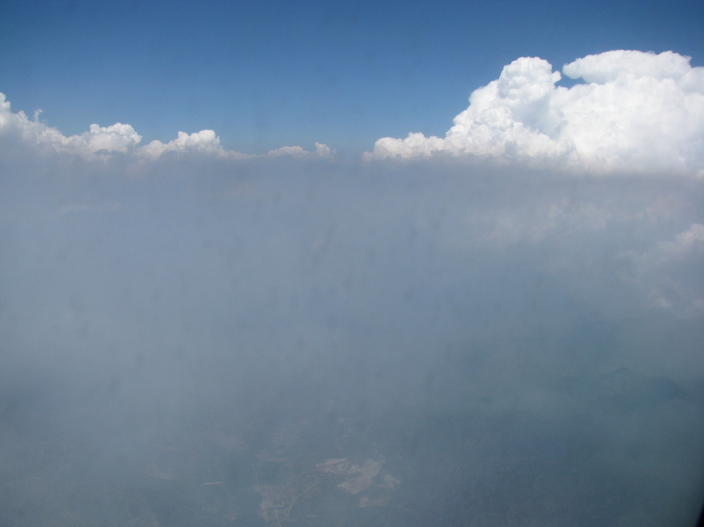
A Dictionary of Aerosol Remote Sensing Terms
Short
Richard Kleidman
SSAI/NASA Goddard
Lorraine Remer
UMBC / JCET

Slide 2
Let’s look at 3 kinds of properties that are
important to understand about aerosols
Chemical Properties
Physical Properties
Optical Properties
These two types of
properties are very closely
linked in remote sensing
because we infer the
Physical properties from
Optical measurements
Because we measure the entire atmospheric column our properties
represent the mean particle characteristics

Slide 3
Physical Properties
Aerosol Amount
AOD (τ) - Aerosol Optical Depth
AOT - Aerosol Optical Thickness
These optical measurements of light extinction are used to represent aerosol amount in the entire column of the atmosphere.
AOD is wavelength dependent
Notes:
The terms Aerosol Optical Depth (AOD) and Aerosol Optical Thickness (AOT) are most often used interchangeably in remote sensing aerosol science. The technical definition of each term is provided at the end of this presentation.

Slide 4
Physical Properties
Aerosol Amount
AOD is a unitless value.
Sample AOD values:
0.02 - very clean isolated areas.
0.2 – fairly clean urban area
0.4 – somewhat polluted urban area
0.6 – fairly polluted area
1.5 – heavy biomass burning or dust event

Slide 5
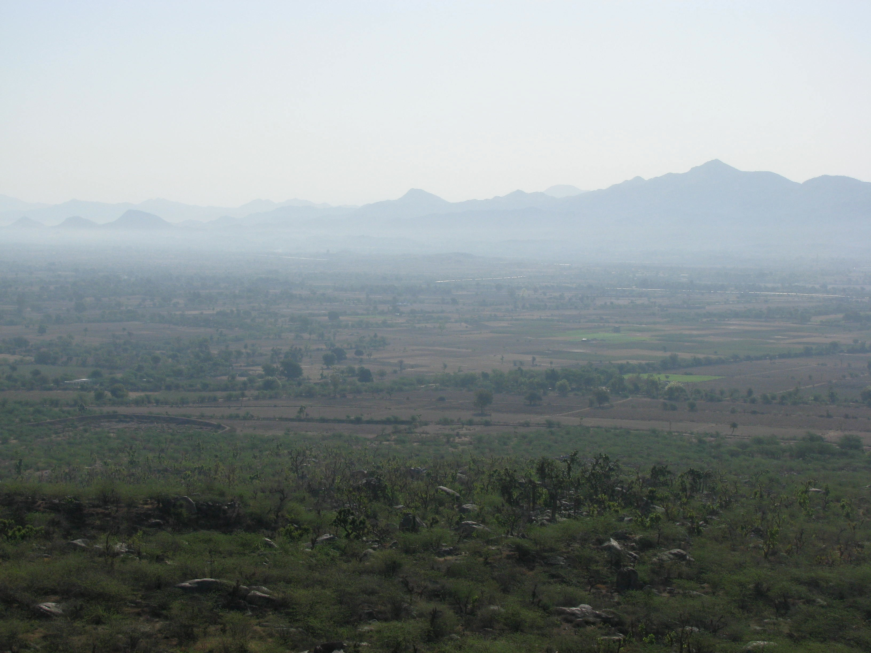
Moderate AOD ~0.40
Near Mt. Abu, India
Photo courtesy of Brent Holben
Notes:
The aerosol in this photo appears to be fairly evenly distributed throughout the atmosphere.

Slide 6
Heavy AOD
Below the planetary boundary layer
Photo courtesy of Brent Holben
Notes:
This slide and the last one give examples of moderate and heavy aerosol loading. In this photo most of the aerosol is held below the boundary layer. From the AOD value alone one cannot determine the vertical distribution of the aerosols and in fact the last slide and this one could theorectically have the same AOD value.

Slide 7
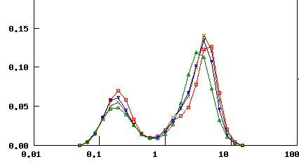
Physical Properties
Particle Size Distribution – aerosols in the optically active size ranges
are best represented as a bimodal distribution. The aerosol size distribution
can be represented as a volume or number distribution.
dV / dlnr
Radius (μm)
The mode representing the small (fine mode) aerosol has a size distribution
centered on radii between 0.1 and 0.25 microns.
The mode representing the large (coarse mode) aerosol has a size distribution
centered on radii between 1 and 2.5 microns.

Slide 8
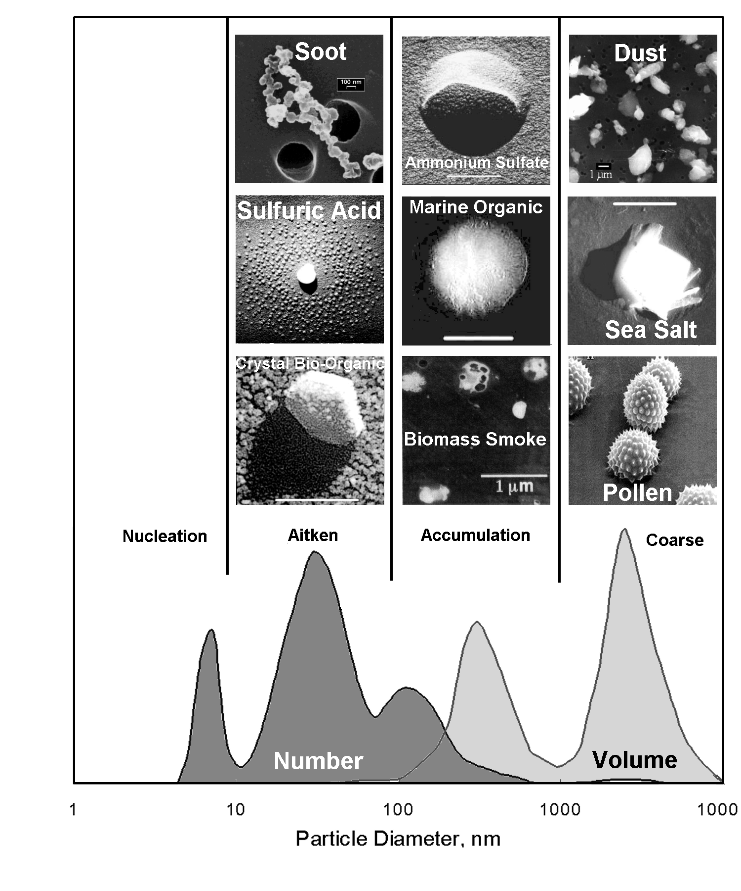
Physical Properties
Fine and
accumulation
mode are the
same thing
These Aerosols have the largest impacts on radiative budget, visibility, cloud processes and health issues
0.001 0.01 0.1 1.0 10.0
Radius, μm
UV BGR NIR IR
Notes:
Picture of various types of aerosols. Fortunately the ones that have the most impact on climate are in the size range that we can observe from space.

Slide 9
Why is Size Distribution Important?
MAN MADE – A result of a combustion process
Smoke
(Biomass Burning) Small (fine mode)
Industrial Pollution
NATURAL – A result of a wind or erosion process
Sea Salt
Dust Large (coarse mode)
Notes:
We generally associate the fine mode aerrosols with human (anthropongenic) origins and coarse mode aerosols with natural processes. This can give us an indecation of the source of aerosols and/or the overall effect of human activities.

Slide 10
Physical Properties
Fine Fraction
A simple ratio of the volume of fine particles to the
total volume of particles.
Values range from 0 - 1
Fine AOD
The fraction of light extinction due to particles in the
fine mode.
Total AOD x Fine Fraction

Slide 11
Physical Properties
Aerosol Amount - AOD, AOT
PM _{2.5} - particles of less than 2.5 µm aerodynamic diameter
These can penetrate deeply into the lungs
PM _{2.5} concentration at ground level is an important parameter for air quality studies.
Aerosol Mass Concentration - Mass / cm² (MODIS Units)
CCN (Cloud Condensation Nuclei) Concentration.
These are particles that act as condensation surfaces and
encourage water droplet formation within clouds.

Slide 12
Physical Properties
PM _{2.5} cannot be directly measured by satellite sensors.
This is because the aerosol measurements are for the entire column and over land cannot be well apportioned into fine and coarse modes.
Model anaysis and ground data are used in conjuction with satellite data to
estimate ground level PM.

Slide 13
Physical Properties
Particle shape - spherical, spheroid, non-spherical
Particle shape can:
be indicative of the source and age of the particle
influence climate processes
affect how active aerosols are in the lungs

Slide 14
Optical Properties
Optical properties are important for several reasons
Their effect on the radiative balance of the Earth’s environment
Their effect on heating of the atmospheric column which can change circulation and affect the water cycle
Visibility

Slide 15
Optical Properties
Light Scattering
Light Absorption
These quantities are difficult
to separate and measure individually
Single Scattering Albedo - a measure of how absorbing
or scattering we consider the mass of aerosol particles to be.
Extinction = Scattering + Absorption
AOTscatter
ω_{o} = _________________________________
AOTscatter + AOTabsorption
Values of .85 are considered very absorbing
Values of .95 are considered very non-absorbing
Notes:
Very high values of single scattering albedo are often associated with sulfate pollution.

Slide 16
Optical Properties
Complex Index of Refraction
Real Component - refers to light bending
Imaginary Component - refers to light absorption due
to the material

Slide 17
Radiative Transfer
The physics and mathematics of how radiation passes through a medium that may contain any combination of scatterers, absorbers, and emitters.

Slide 18
Aerosol Inversion
Using the measured optical properties
to infer the physical characteristics of the
Aerosol.
This is performed by an inversion of the
Radiative Transfer Equations.

Slide 19
Aerosol Inversion
Usually we start with the object and obtain the measured properties.
An inversion works backwards.:
We start with a set of measured properties that are used to idenfity
the physical object.
Since there are many possible physical objects that can produce the measurements we have obtained we rely on several assumptions in an aerosol inversion.
These assumption are based on many years of physical observations and
are not “guesswork”.

Slide 20
End Part 1

Slide 21
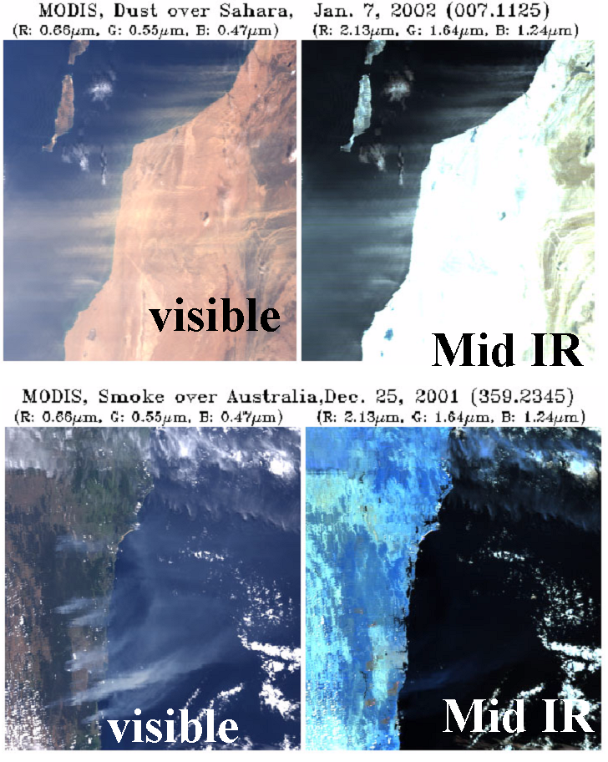
Spectral optical properties of aerosol
Both dust and
smoke interact
with the shorter
wavelengths
reflecting light
back to the sensor.
The larger
dust particles
interact with the
longer infrared
wavelengths
but the smoke
particles are not
detected.
Dust
Smoke
This distinction
is made
possible by the
wide spectral
range of the
MODIS sensor.
from Y. Kaufman

Slide 22
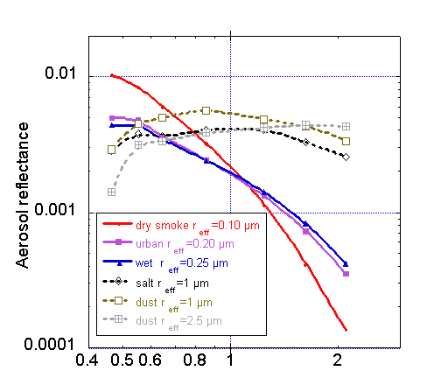
Spectral optical properties of aerosol
Note that the
large particles
produce a high
response across
the spectral range.
Here you
can see the
spectral
response
of the large
and small
particles.
Dust / Sea Salt
Smoke / Pollution
The small particles
produce weaker
responses as
the wavelength of
the light increases
wavelength in µm

Slide 23
Physical Properties
Angstrom Exponent α
The Angstrom exponent is often used as a qualitative
indicator of mean aerosol particle size in the measured column
Values greater than 2 – small particles
Values less than 1 – large particles
For measurements of optical thickness
τ_{λ1 and} τ_{λ2} taken at two different wavelengths λ₁ and λ₂₁
τ_{λ1}
τ_{λ2}
ln
α = -
λ₁
λ₂
ln

Slide 24
Physical Properties
The angstrom exponent really represents the slope
of the spectral response.
For measurements of optical thickness
τ_{λ1 and} τ_{λ2} taken at two different wavelengths λ₁ and λ₂
wavelength in µm

Slide 25
End Part 2

Slide 26
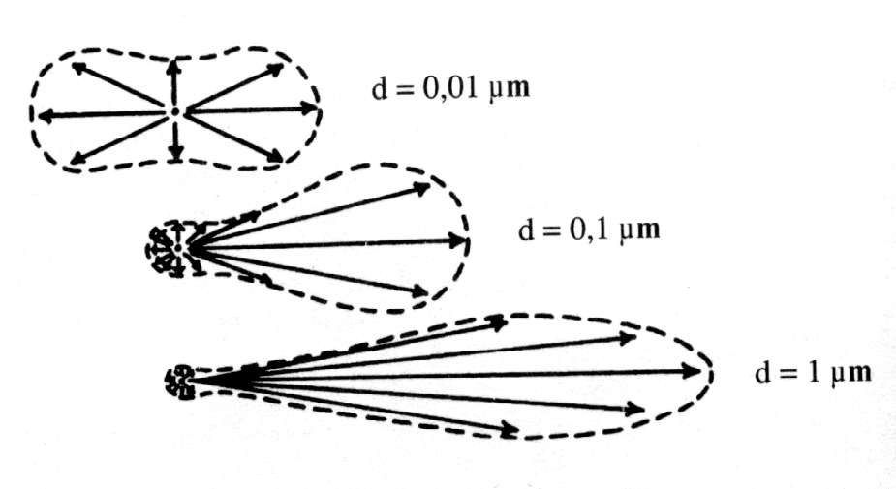
Optical Properties
Scattering Phase Function
The directional light scattering
due to the aerosol particles
Backscatter
Forward scatter
Incoming
Radiation

Slide 27
Optical Properties
Scattering Phase Function – the amount of light scattered
in each direction relative to the incoming direction.

Slide 28
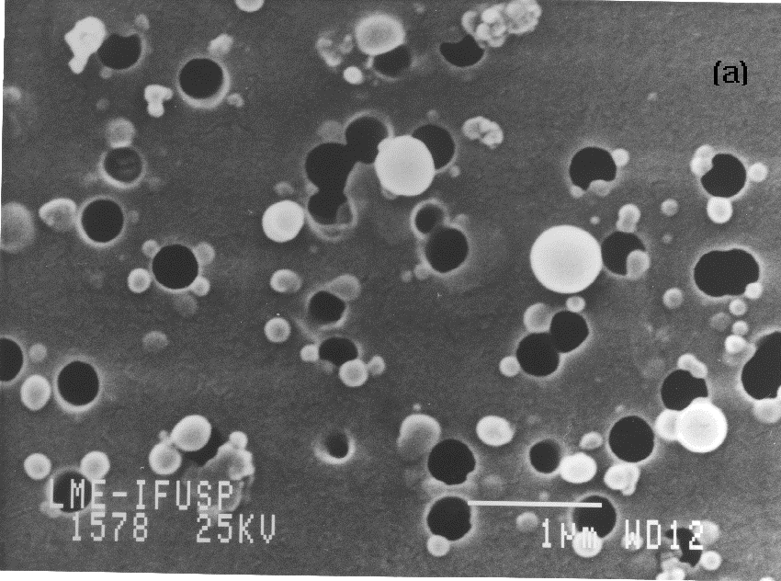
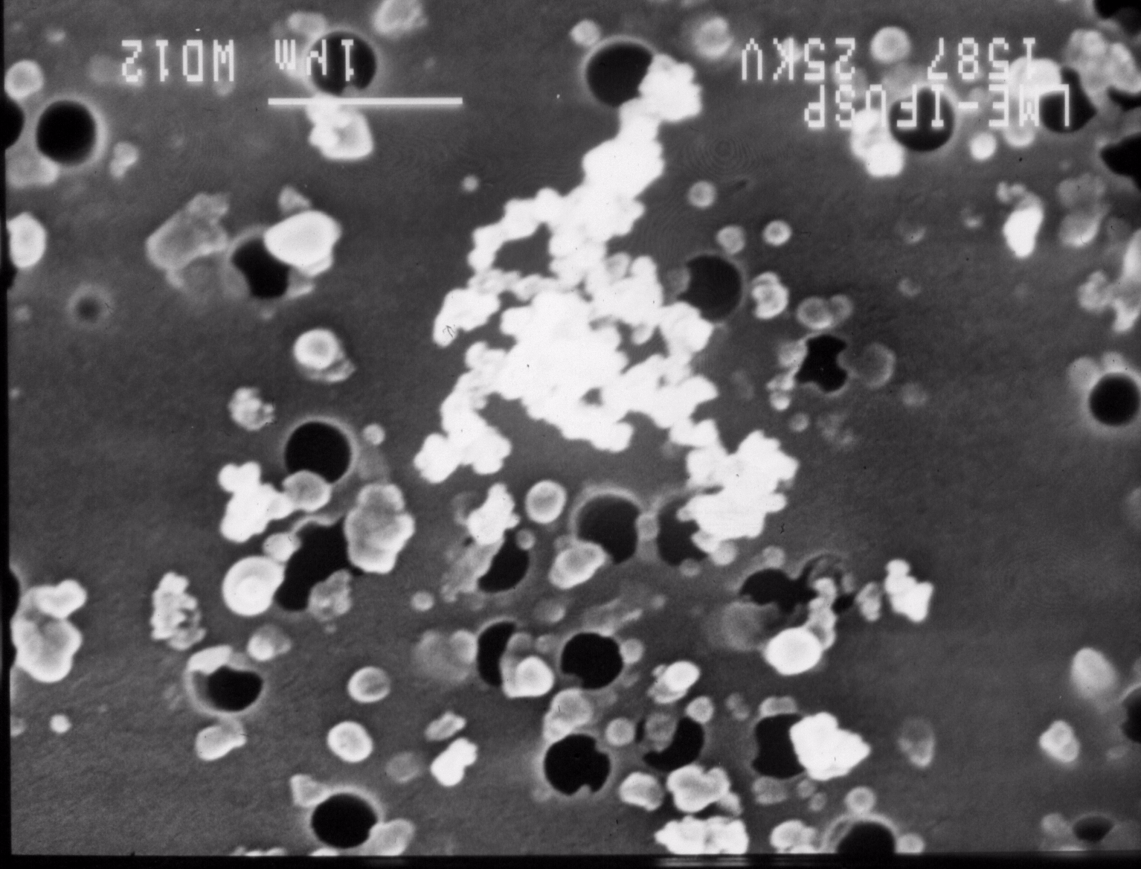
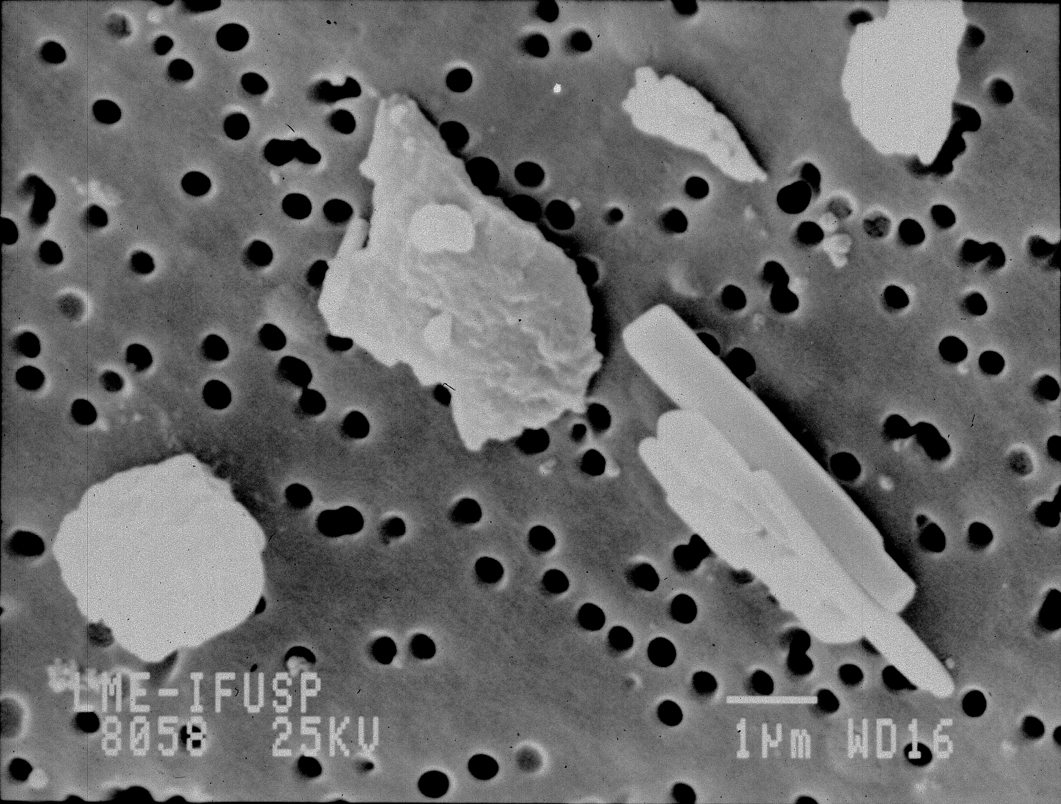
Typical aerosols and their properties
flaming SMOKE smoldering
The phase function:
relative angular distribution of scattered light
heavily depends on the size and shape of aerosol particles

Slide 29
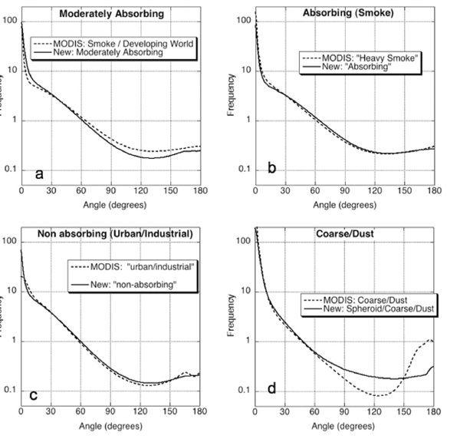
Optical Properties
Sample Phase Functions

Slide 30
Notes:
For those who would like a more precise definition of Aerosol Optical Depth (AOD) and Aerosol Optical Thickness (AOT) we present this slide courtesey of Michael King.

