Slide 1
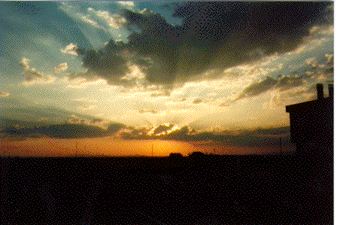
An Introduction to Using Angular Information in Aerosol Remote Sensing
Richard Kleidman
SSAI/NASA Goddard
Lorraine Remer
UMBC / JCET
Robert C. Levy
NASA GSFC
Revised November 2014

Slide 2
This presentation is intended to provide some basic information on
how measurements at multiple angles are used in the remote sensing of aerosols.
This information is applicable and important for satellite remote sensing and
measurements using ground instrumentation.
A more complete picture of remote sensing of atmospheric aerosols can be
obtained when viewing this presentation in conjunction with
“An Introduction to Using Spectral Information in Aerosol Remote Sensing”

Slide 3
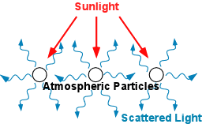
The atmospheric aerosols which we can measure using remote sensing
instruments interact with incoming solar radiation in many ways.
One of those interactions is light scattering

Slide 4
The amount and direction of scattering is dependent on
- particle size
particle shape
chemical composition of the particles

Slide 5
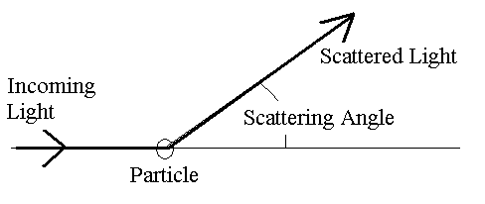
For any particular scattering event we can define the scattering angle.
If the light does not change its path at all the scattering angle is 0°
If the light is scattered back towards its direction of origin the scattering angle is 180°

Slide 6
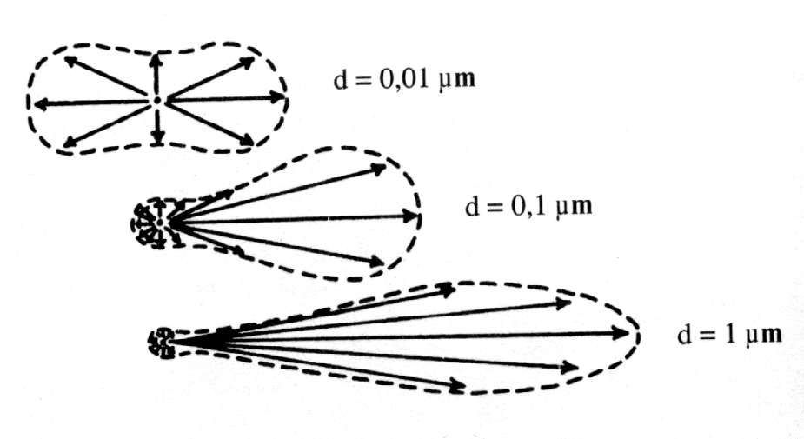
Optical Properties of Aerosols
Particles of differenct sizes, shapes and/or compositions will scatter different proportions of the incoming radiation in different directions.
Backscatter
Forward scatter
Incoming
Radiation
Notes:
Here we use drawings to represent the probability that light will be scattered in various directions by a particle or mass of particles. The top particle scatters light almost equally in all directions. The middle particle moderately favors scattering in the forward directions. The bottom particle strongly favors forward scattering.

Slide 7
Scattering Phase Function – the amount of light scattered
in each direction relative to the incoming direction.
We calculate the sum of
the scattering in each direction
More points will produce a more
accurate phase function
We use the points to
graph the scattering
phase function.
Phase functions can be diagnostic
for different aerosol types.
90°
0°
180°
Notes:
Here we take the pictoral representation of the scattering for the third particle and turn it into a graphical representation. We add up the scattering for each angle and draw it as a point on the graph.

Slide 8
The Uses of Angular Information in Remote Sensing Instruments

Slide 9
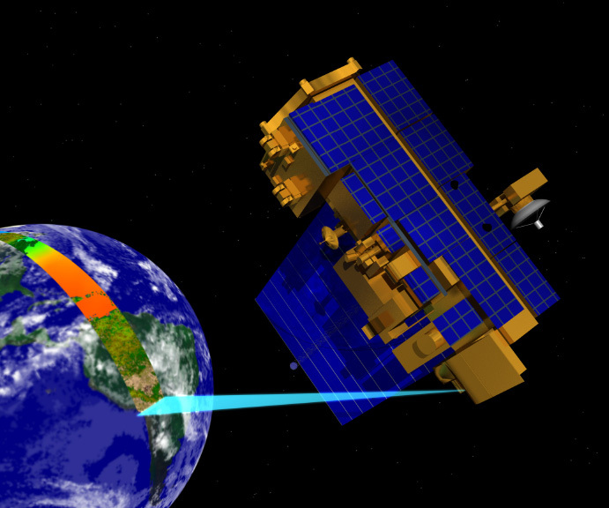
MODIS Satellite Sensor
MODIS observes the earth in a wide swath.
Each target is observed in 36 spectral bands
Each target is observed at a single scattering angle.

Slide 10
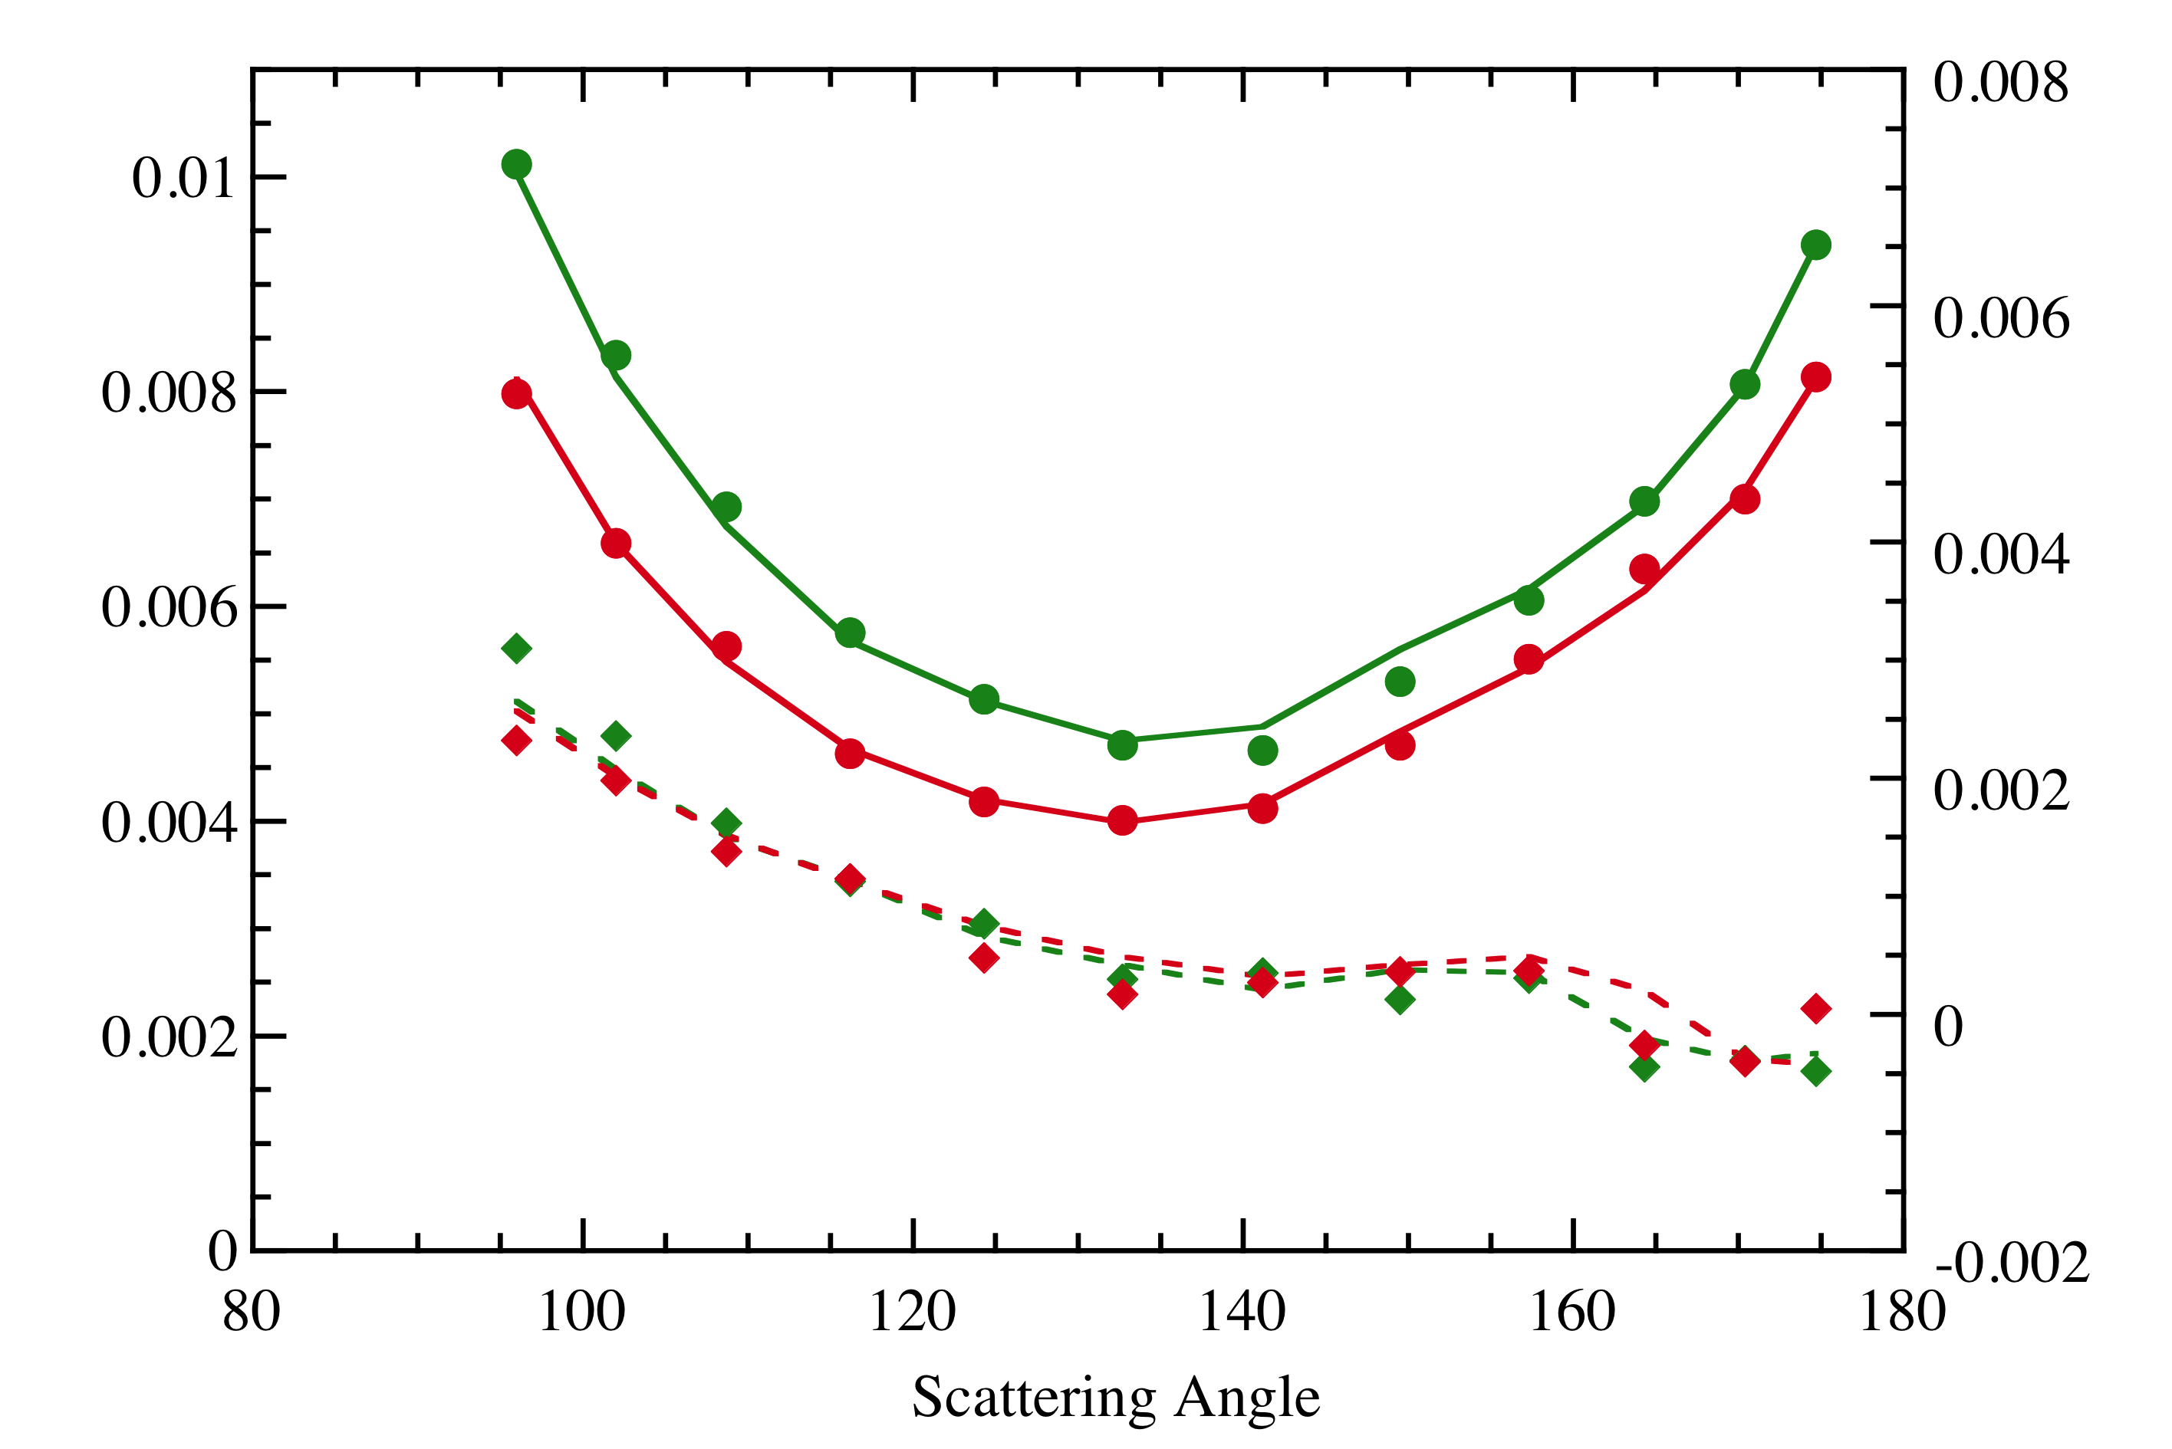
Below is a simulated signal that might be detected by the MODIS sensor at the seven wavelenghts it uses to analyze aerosols. Each colored dot represents the signal at a different wavelength Each target is only observed at a single scattering angle
Many channels
One direction
Reflectance
Scattering Angle
Notes:
The MODIS sensors onboard the Terra and Aqua satellites have a broad spectral range. As the sensor passes over a target it will record the information in 36 wavelenghts. However it will only view each target at a single scattering angle. MODIS cannot be used to construct a single scattering phase function.

Slide 11
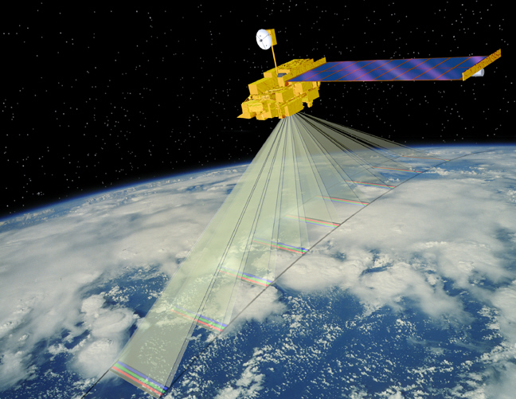
MISR
The MISR instrument has 9 cameras each one positioned at a different viewing angle. Each target is viewed at nine scattering angles.
Each target is also observed in four wavelengths.

Slide 12
Simulated MISR data at 9 scattering angles.
Each view has 4 spectral channels.
MISR
Multi-directional
measurements
Reflectance
Scattering Angle
Notes:
Here we simulate the data available from MISR observations. Although the spectral information is limited compared to MODIS the data for each of the four wavelengths is recorded at nine different scattering angles for each target.

Slide 13
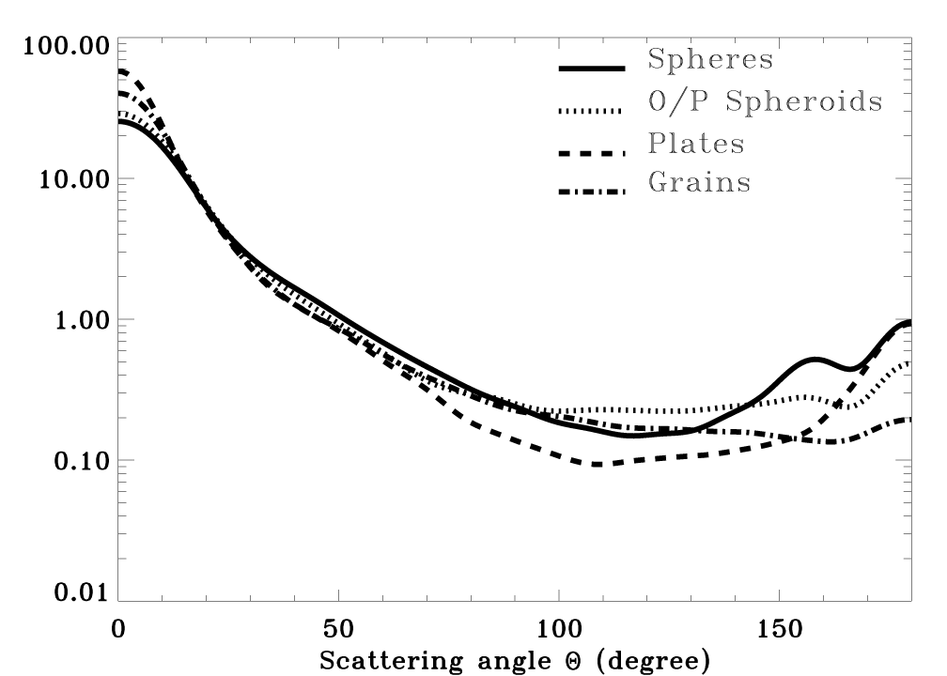
Single-scattering Phase Functions for Different Particle Shapes
Kalashnikova & Kahn, JGR 2006
Notes:
Here you can see some distinctive scattering phase functions for different shapes of particles. There are also distinctive scattering phase functions based on particle size and composition.
These phase functions are used in the MISR aerosol algorithm.

Slide 14
Introduction to the AERONET Sunphotometer Ground Based Network
Richard Kleidman
SSAI/NASA Goddard
Lorraine Remer
UMBC

Slide 15
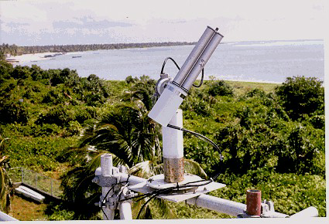
Intro to AERONET
Aerosol Robotic Network
http://aeronet.gsfc.nas.gov
PI: Brent Holben, NASA GSFC

Slide 16
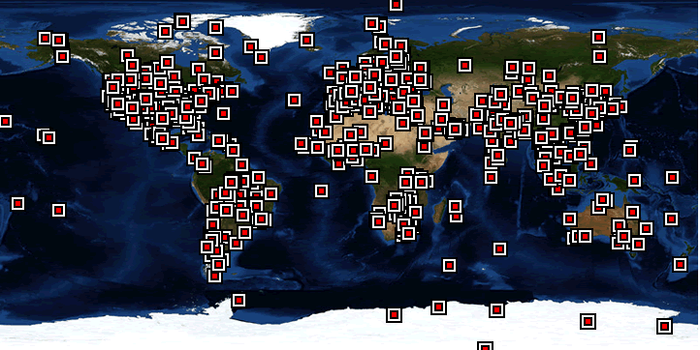
Aeronet is a global network of instruments which measure column aerosols from the ground looking up towards space
Each square represents a current or past aeronet station

Slide 17
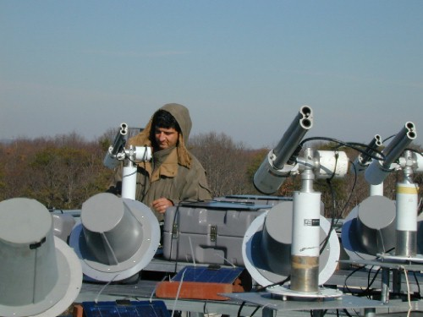
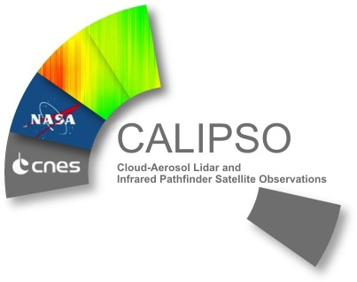
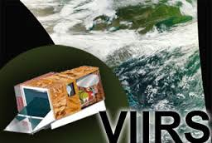
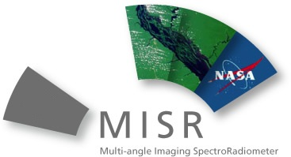
Aeronet is valuable because:
The data is important for understanding global aerosols
The data provides crucial information for developing
satellite retrievals
Aeronet data provides a validation set used by all spaceborne
aerosol measuring sensors.

Slide 18
Aeronet data collection
Columnator points to target (sun or sky).
Filter wheel with 4 – 8 filters.
Notes:
The aeronet instrument is programmed to point towards the sun and take data several times per hour. The filter wheel rotates through the set of filters and takes data in triplicate.
Once per hour the instrument will point to the sun and then maintaining the same angle rotate to point all around the sky.

Slide 19
Aeronet Data
Direct Sun Measurement – Spectral Data
Instrument points directly at sun
Rotates through filter wheel taking 3
sets of measurments
Notes:
The aeronet instrument is programmed to automatically point towards the sun and take data several times per hour. The filter wheel rotates through the set of filters and takes data in triplicate.

Slide 20
Aeronet Data
Diffuse Sky (“Almucantar”) Measurement – Spectral and Angular Information
Instrument points directly at sun
Rotates through filter wheel taking 3 sets of measurments
Instrument stays at same pointing elevation and rotates
pointing all around the sky taking three sets of measurements at each stop.
The complete set of measurements
is repeated three times.
Notes:
The aeronet instrument is programmed to point towards the sun and take data several times per hour. The filter wheel rotates through the set of filters and takes data in triplicate.
Once per hour the instrument will point to the sun and then maintaining the same angle rotate to point all around the sky.

Slide 21
Comparing Aeronet Measurement Types
Direct ‘sun’
Approx 4 per hour
Measurements of direct solar extinction in ≥4 λ.
Assumes molecular and gas extinction.
Derives spectral aerosol optical depth (AOD)
--> relative aerosol size
Derives H₂O optical depth from 936 nm.
Diffuse ‘sky’
Approx 1 per hour, + specific times
Measurements of sky radiance in 4 λ (1020, 870, 670 and 440 nm)
At discrete azimuth angles along sun’s ‘almucantar’ (constant θ₀)
At discrete zenith angles along sun’s ‘principle plane’ (constant φ₀)
Uses radiative transfer to invert spectral/angular radiance to retrieve aerosol size, shape and composition.

Slide 22
More about direct sun
Direct Sun Products:
Spectral AOD (τ_{λ}) (accuracy: Δτ = ±0.01 for L2)
Angstrom Exponent (α)
Total column water vapor (w)
Statistics: Daily averages, monthly averages
Fine and coarse AOD
Fine and coarse fraction of aerosol

Slide 23
More About “Almucantar” Data
Size Distribution
Absorption Optical Depth
Extinction Optical Depth
Single Scattering Albedo

Slide 24
AERONET Data Quality
AERONET data is unique among
sun photometer networks
This is due to the consistent high quality
calibration methodology applied to all
of its instruments

Slide 25
AERONET Data Levels
Level 1.0 - unscreened data; does not have final calibration applied
Level 1.5 - cloud-screened data; does not have final calibration applied.
These data are not quality assured.
Level 2.0 - pre- and post-field calibration applied, cloud-screened,
and quality-assured data
Next data release will have a near-real time level 2 product.
If available: Level 2 is preferred.
( When studying cloud processed aerosols Level 1.5 may be preferred.

Slide 26
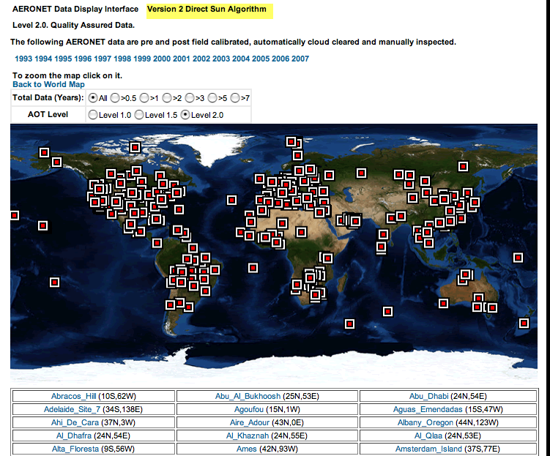
AERONET System Interface

Slide 27
Data can be sorted by:
Location (clicking on the map)
Location (site list)
Data Level
Dates of available data
Length of data record

Slide 28
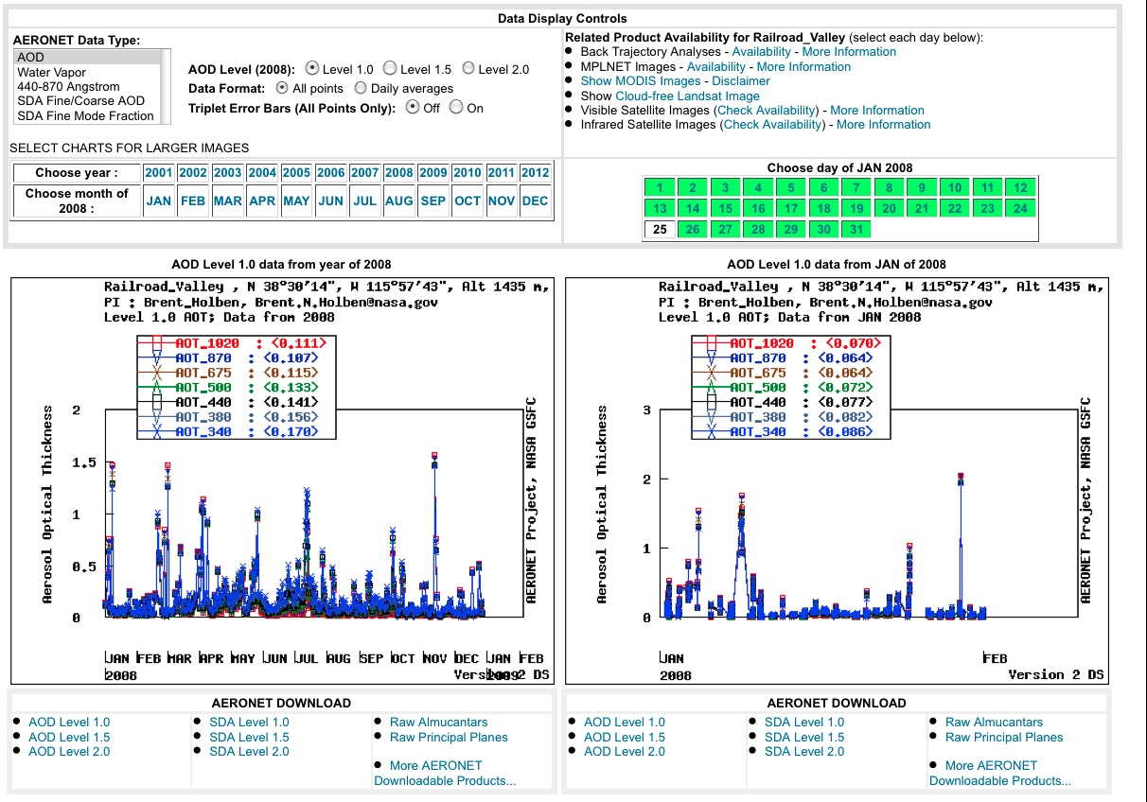
Aeronet Site Data Interface
Select
data type
Select data level and format
Select
month or
year
Select
day
Available wavelengths for this instrument
Number in brackets
is average value for
the time period
Data Plots
Yearly
Monthly

Slide 29
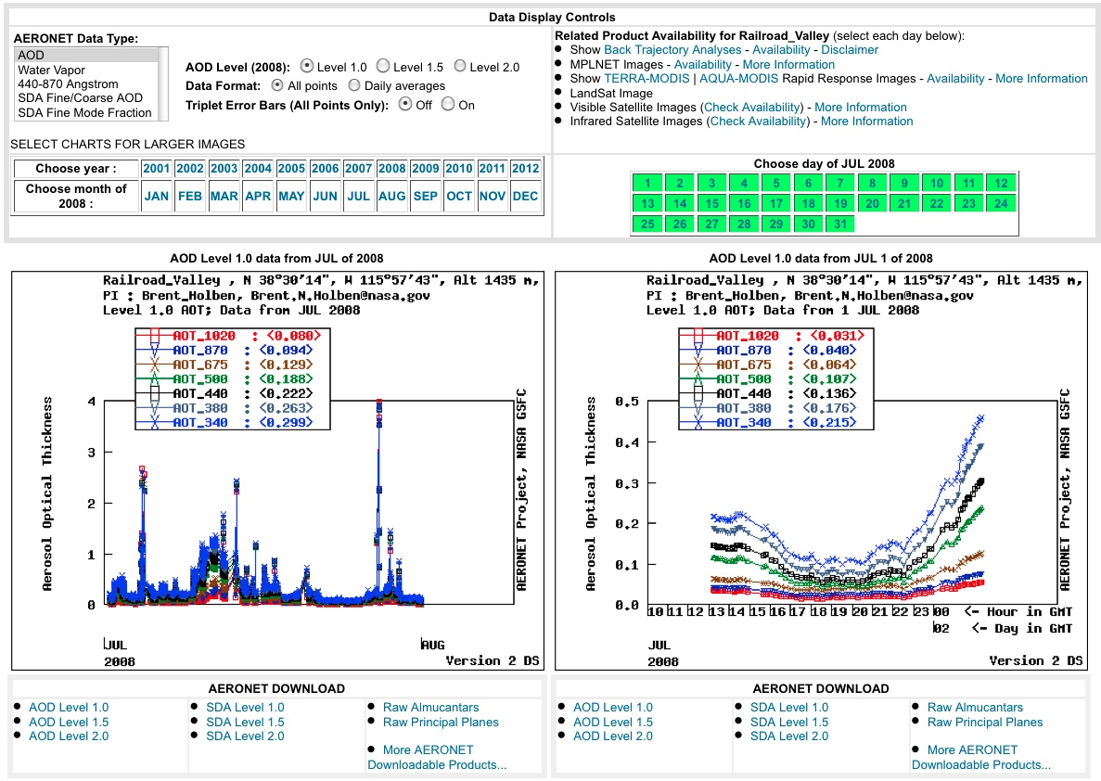
Aeronet Data
Select
data type
Select data level and format
Select
month or
year
Select
day
Available wavelengths for this instrument
Number in brackets
is average value for
the time period
Data Plots
Monthly
Daily

Slide 30
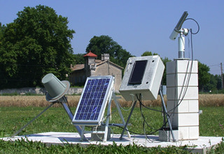
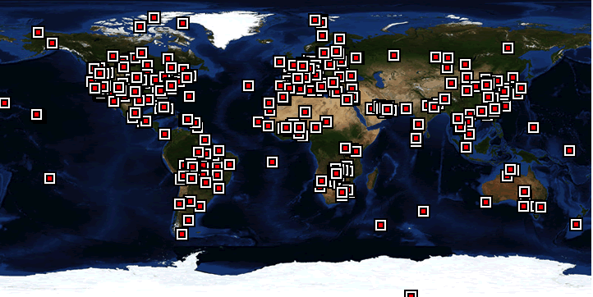
Using Aeronet for Satellite Validation
Satellite and Aeronet data are spatially and temporally matched
MODIS data within 27.5 Km radius of
aeronet station
Aeronet measurements within
+/- 30 minutes of satellite overpass
50 km
10 km
10 km
50 km

Slide 31
Reference Slides

Slide 32
Sunphotometry
Measurement of the sun direct beam
Direct application of Beer-Bouguer-Lambert’s extinction law
L_{λ} = F_{0,λ} exp[-τ_{λ}m]
where λ is wavelength, m=m(θ₀) is “air mass” (function of solar zenith angle, θ₀), L=L(θ₀) is radiance, F₀=F₀(θ₀) is solar irradiance and τ is total optical depth.
Total optical depth is sum of contributions from molecular scattering, gas absorption, aerosol scatter/absorption, and cloud scattering/absorption.
Depending on wavelength (λ), different assumptions can be made to neglect one or more of the contributing optical depths.
Sunphotometer measurements date back to early 1900’s via pioneering work of Ångstrom.

Slide 33
Hundreds of Nearly Identical Sunphotometers (CE-318)
Manufactured by Cimel Electronique (France)
CE-318-1: Standard Model (with 1020, 870, 675, 440, 936, 340 and 380 nm filters)
CE-318-2: Polar Model (with 1020, 870P1, 675, 440, 870P2, 870, 936, and 870P3 nm filters)
CE-318-N (after 2004): Models with varying # of filters, wavelength ranges, polarization, etc.
Robot mount for automatic sun tracking
Includes satellite transmitter for remote deployment
Owned by P.I.
Operated and deployed by GSFC AERONET team
Carefully calibrated at GSFC before and after field deployment.
Products quality controlled at GSFC
Primarily to retrieve aerosol properties, but also cloud properties, gas and H₂O absorption.
Originally, AERONET intended for “ground truth” for EOS.

Slide 34
More about diffuse ‘sky’
Measurement of spectral sky reflectance
Plus assumptions of surface optical properties at site (MODIS surface albedo products)
Results
Size distribution in 22 size bins --> comparable aerosol lognormal properties (assuming two modes)
Spectral absorption (and single scattering albedo, ω₀)
Refractive Index (complex)
Phase function (+ Assymetry Parameter)
Fine and coarse aerosol AOD and fraction
Percentage of spherical and spheroid particles
High Accuracy requires some constraints
large aerosol signal (e.g., τ > 0.4 at 0.44 μm)
large sun angle (Θ₀ ≥ 50°)
Minimum number of “symmetric” angles (homogenous sky)
“Level 2” product is quality controlled
Statistics (daily and monthly averages), Error bars

